Slide 1
Accurate and Scalable Gaussian Processes for Fine-grained Air Quality Inference
Zeel B Patel, Palak Purohit, Harsh Patel, Shivam Sahni, Nipun Batra
IIT Gandhinagar
AAAI 2022
Notes:
Hi Everyone, I am Zeel and I am going to present our work “Accurate and Scalable Gaussian Processes for Fine-grained Air Quality Inference”.

Slide 2
Motivation
8 M deaths per annum worldwide: WHO
90% of the world breathes low quality air
Sparse and non-uniform AQ stations (India has 573 over the demand of 4K)
Stations are costly
src:https://indianexpress.com/article/india/at-2-5-million-india-tops-list-of-pollution-linked-deaths-study-4898337/
Notes:
8 million people in the world die each year due to indoor and outdoor air pollution. More than 90% of the world population breathes a low quality air that violates WHO standards. Thus, there is a need for air pollution mitigation policies across the world. However, air quality monitoring is sparse and non-uniform. For example, a country like India, has only 573 continuous monitoring stations over the need of 4000 stations, as per the air quality experts. Each station is very costly to install and maintain and thus, air quality inference is required to get fine-grained air quality estimation at the unmonitored locations.

Slide 3
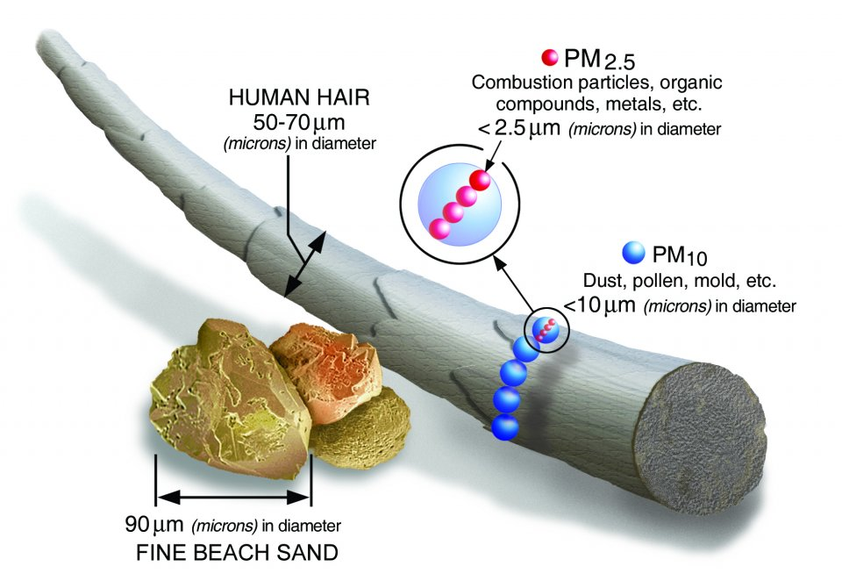
Particulate Matter : 2.5 microns (PM_{2.5})
src:https://www.epa.gov/pm-pollution/particulate-matter-pm-basics
src:https://mypositiveparenting.org/2019/11/21/air-pollution-and-health/
Notes:
Air that we breathe contains various air pollutants. Among those, particulate matter of size less than 2.5 microns, also known as PM2.5, is most harmful to human health. To get an idea of how small 2.5 microns is, think about a single human hair which is about 50 to 70 microns in diameter. PM2.5 is 30 times smaller than that. Sources of PM2.5 include vehicular and industrial emissions, open fire and construction activities among others. PM2.5 particles can get deep to our lungs and pose the greatest risk to health. Thus, in this work we focus only on PM2.5 pollution.

Slide 4
Problem: Air Quality Inference
Time (T)
Temperature
Humidity
AQ stations
(Lat: 39.9,
Long: 116.2,
PM2.5: 145)
?
?
?
?
Wind
Weather
Latitude
Weather stations
?
?
?
?
?
?
?
(Temp : 28 ℃,
Humidity:70%,
Wind speed: 6 km/h,
Weather: sunny)
(Lat : 39.6,
Long: 116.4,
PM2.5: ?)
Longitude
Notes:
Our problem statement is as the following: Let us consider a city, and for simplification assume it to be a square grid. Given air quality data from S monitors along with relevant features such as Longitude, latitude, and meteorological features from nearby weather stations such as Temperature, Humidity, Wind and Weather for Time period T, Our aim is to predict air quality at a set of unmonitored locations during the same time-period T.

Slide 5
AQ stations
(Lat: 39.9,
Long: 116.2,
PM2.5: 145)
?
?
?
?
Latitude
Weather stations
?
?
?
?
?
?
?
(Temp : 28 ℃,
Humidity:70%,
Wind speed: 6 km/h,
Weather: sunny)
(Lat : 39.6,
Long: 116.4,
PM2.5: ?)
Longitude
Notes:
Our problem statement is as the following: Let us consider a city, and for simplification assume it to be a square grid. Given air quality data from S monitors along with relevant features such as Longitude, latitude, and meteorological features from nearby weather stations such as Temperature, Humidity, Wind and Weather for Time period T, Our aim is to predict air quality at a set of unmonitored locations during the same time-period T.

Slide 6
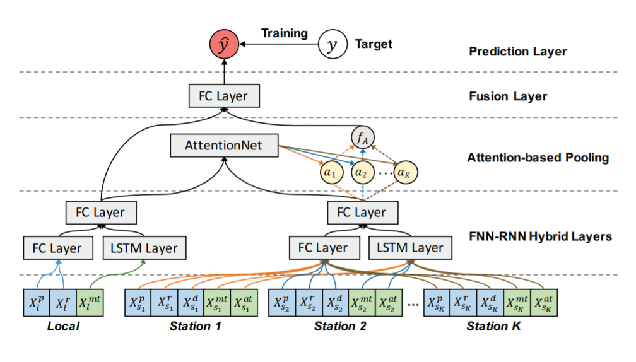
Related work
Attentional Deep Air Quality Inference Network
Shortcomings
No scope for domain knowledge
No uncertainty provision
src: Cheng, W., Shen, Y., Zhu, Y., & Huang, L. (2018). A Neural Attention Model for Urban Air Quality Inference: Learning the Weights of Monitoring Stations. Proceedings of the AAAI Conference on Artificial Intelligence, 32(1).
Notes:
Let us now look at the state-of-the-art in air quality inference and discuss its shortcomings.
A neural attention based approach called Attentional Deep Air Quality Inference Network, or in short ADAIN, was proposed in AAAI 2018. ADAIN framework is capable of incorporating both time-series and time-invariant features into the model. It also learns the attention weights associated with the training stations.
However, it is difficult to incorporate domain knowledge into the model and it does not provide uncertainty about the predictions, which can be very useful in air quality domain.

Slide 7
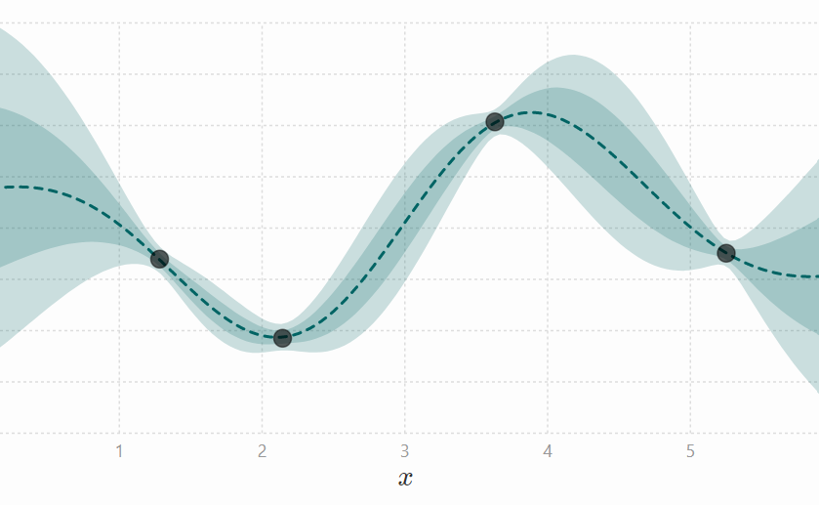
Our Approach: Gaussian Process (GP) Regression
Data Points
Predictive Mean
Predictive
1 std
Predictive
2 std
src: http://www.infinitecuriosity.org/vizgp/
Notes:
To overcome these shortcomings, we propose a Bayesian non-parametric approach called Gaussian process regression or in short GPs. GPs can incorporate domain knowledge with help of covariance functions or kernels. They also inherently provide the uncertainty about their predictions.

Slide 9
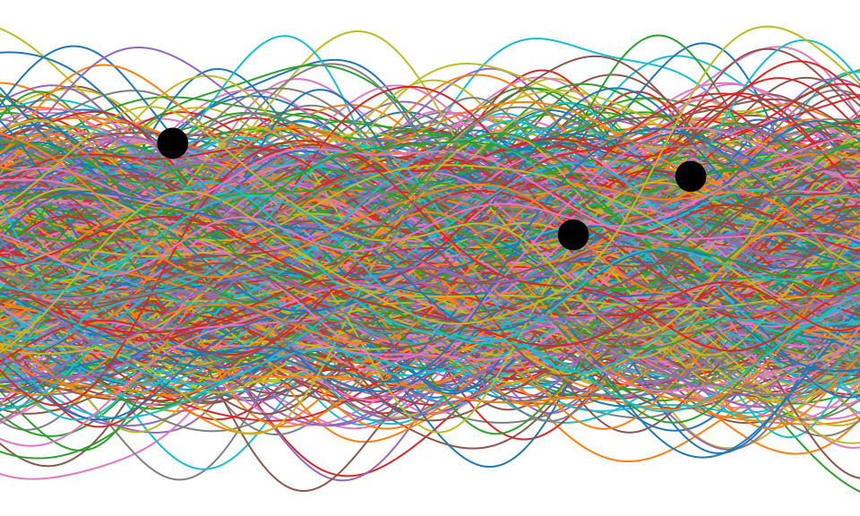
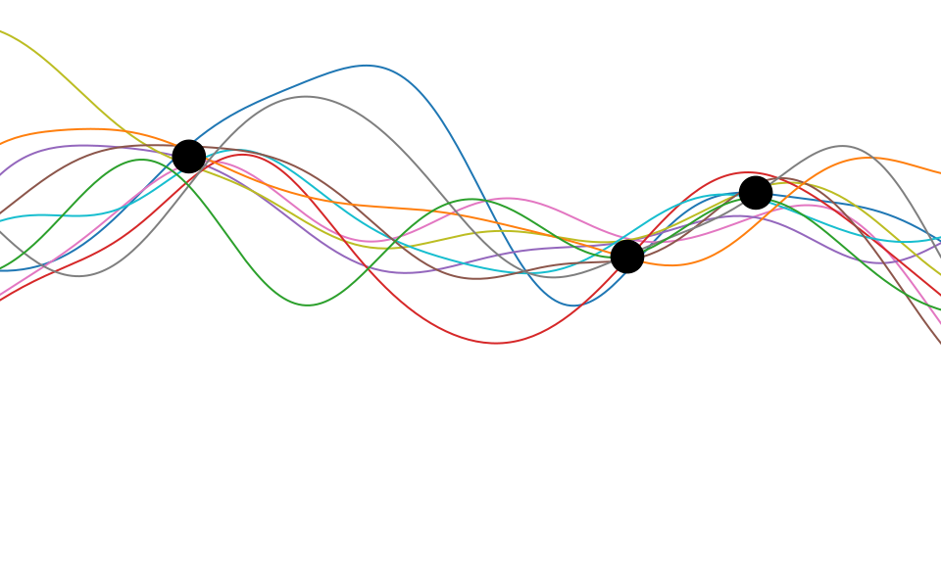
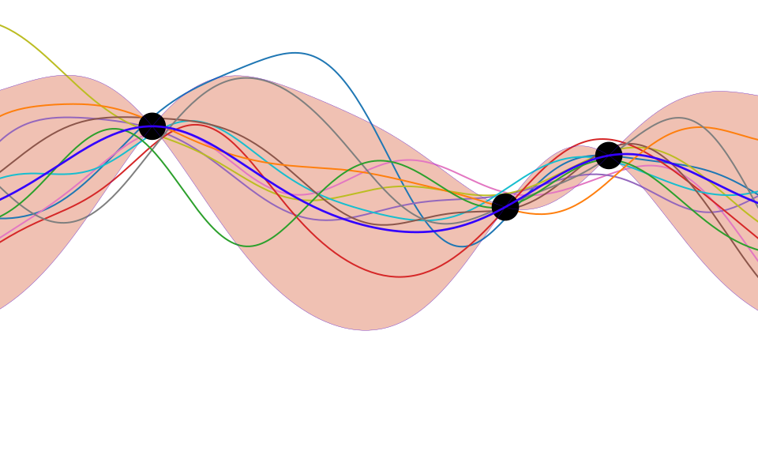
Gaussian Process Regression : Intuition
src: http://inverseprobability.com/talks/notes/gaussian-processes.html
Notes:
The intuition behind GPs can be given by idea of rejection sampling. First we assume a prior distribution of functions that can model our data points with help of covariance functions. Then we draw infinite many functions from the distribution. Now we reject all the functions inconsistent with the data points, and, effectively get the posterior distribution over the remaining functions. In practice, the posterior distribution can be calculated exactly or approximately with posterior equations.

Slide 10
Gaussian Process Regression - Prior
j
i
Mean vector
Cov matrix
Cov function
Notes:
In GPs, design of the Prior has the direct impact on quality of the resultant fit. Mean of the prior distribution is assumed to be a zero vector without the loss of generality and covariance matrix is modelled with a covariance function. More precisely, each entry of the covariance matrix is generated by computing the covariance between inputs x_i and x_j with a covariance function. Here x_i represents a feature vector.

Slide 11
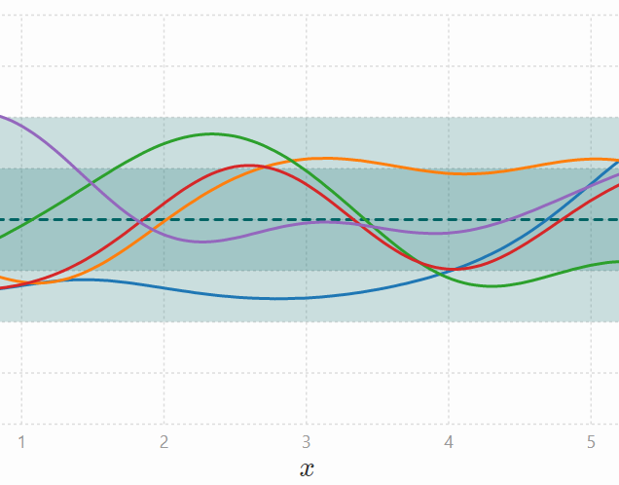
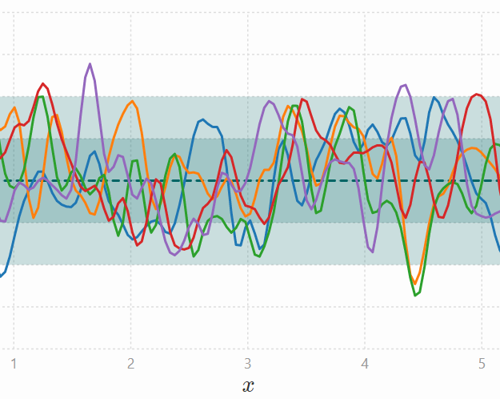
Domain Inspired Kernels (Covariance Functions)
Squared Exponential Kernel
Length scale (𝑙) = 1
Length scale (𝑙) = 0.1
Notes:
Kernels are the key components of GPs and they have several hyperparameters to control their behavior.
For example, Squared Exponential kernel generates infinitely flexible functions
and lengthscale hyperparameter controls the smoothness of functions drawn from it.
Larger lengthscale generates relatively smoother functions as shown in the left plot compared to shorter lengthscale as shown in the right plot.

Slide 12
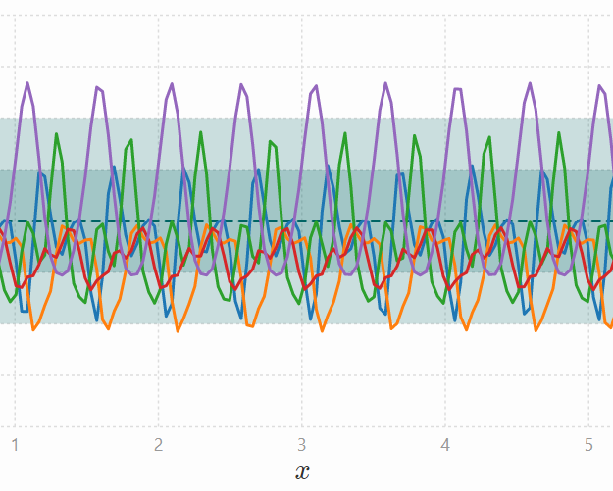
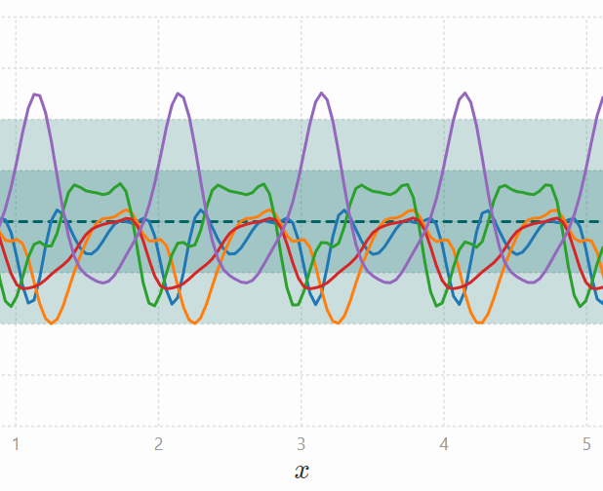
Domain Inspired Kernels (Covariance Functions)
Periodic kernel
Period (𝑝) = 0.5
Period (𝑝) = 1
Notes:
Periodic kernel is useful to model periodic data. It has multiple hyperaparameters namely lentgscale and period. The period hyperparameter can capture the actual periodicity present in the data.

Slide 13
Domain Inspired Kernels (Covariance Functions)
Categorical features
Temporal Features
Continuous Features
Wind direction
Longitude
Latitude
Time
Weather
Temperature
Humidity
Notes:
Leveraging such properties of kernels, we can choose the most suitable kernels to our features. Let us first talk about kernel choice for categorical features in our data.

Slide 14
Domain Inspired Kernels (Covariance Functions)
Type: Categorical
One Hot Encoding
Sample | Wind direction
1 | North (N)
2 | East (E)
3 | South-West (SW)
Sample | N | SW | E
1 | 1 | 0 | 0
2 | 0 | 0 | 1
3 | 0 | 1 | 0
❌
Hamming distance kernel¹
¹Hutter, F.; Xu, L.; Hoos, H. H.; and Leyton-Brown, K. 2014. Algorithm runtime prediction: Methods & evaluation. Artificial Intelligence, 206: 79–111
Notes:
For categorical features, euclidean distance is not meaningful to compute the kernel distance. Thus we use the hamming distance kernel which takes the hamming distance between the categories into account. We note that hamming kernel does not require one-hot-encoding of the categorical features reducing the computational memory requirement.

Slide 15
Domain Inspired Kernels (Covariance Functions)
Categorical Features
Temporal Features
Continuous Features
Wind speed
Time
Longitude
Latitude
Weather
Temperature
Humidity
src: Flaticon.com
Notes:
Now, we will talk about the temporal features.

Slide 16
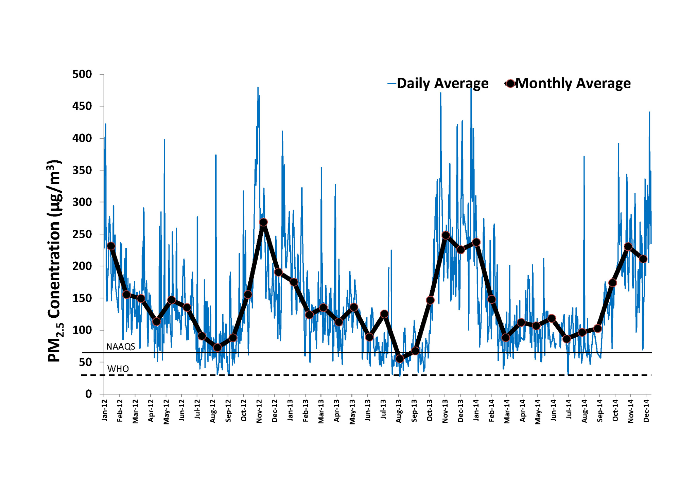
Domain Inspired Kernels (Covariance Functions)
Features: Time
Kernel: Periodic?
Kernel: (Sq. Exp.) ✖ (Periodic)
src:https://urbanemissions.info/delhi-india/delhi-ambient-monitoring-data-timeseries/
Notes:
Air quality data is periodic over time due to multiple factors such as diurnal traffic patterns and seasonal trends over the year. Due to this reason, we can use periodic kernel for time feature. However, data often have variable amplitude and thus to incorporate that, we use multiplicative kernel of Squared Exponential kernel and periodic kernel.

Slide 17
Domain Inspired Kernels (Covariance Functions)
Categorical Features
Temporal Features
Continuous Features
Wind speed
Longitude
Latitude
Time
Weather
Temperature
Humidity
src: Flaticon.com
Notes:
Finally, let us talk about the continuous features.

Slide 18
Domain Inspired Kernels (Covariance Functions)
Features: Longitude, Latitude, Temperature, Humidity
Squared Exponential Kernel
Notes:
When we look at the features like longitude and latitude, we expect air quality to vary smoothly with them and thus squared exponential kernel can be used to model them. Note that we are using a single lengthscale here but smoothness in air quality with respect to latitude and longitude may not be the same.

Slide 19
ARD (Automatic Relevance Determination)
Non-ARD Kernel
ARD Kernel
Notes:
Thus, we enable a property called ARD or automatic relevance determination to allow separate length scales for each feature instead of a common lengthscale in the earlier example.

Slide 20
Domain Inspired Kernels (Covariance Functions)
Features: Longitude, Latitude, Temperature, Humidity
Squared Exponential Kernel
Notes:
Smoothness modeled by lengthscales may not be constant over the space due to multiple sources of air pollution and complexity of air pollution dynamics. For example, PM2.5 relation with latitude can be as shown in this figure. Where smoothness is decreasing with an increase in latitude value and thus lengthscale should also decrease following the same trend as shown in the right figure.
Squared exponential kernel in the current form may find difficulty in modelling this smoothness and that is why now we discuss non-stationarity in covariance structure.

Slide 21
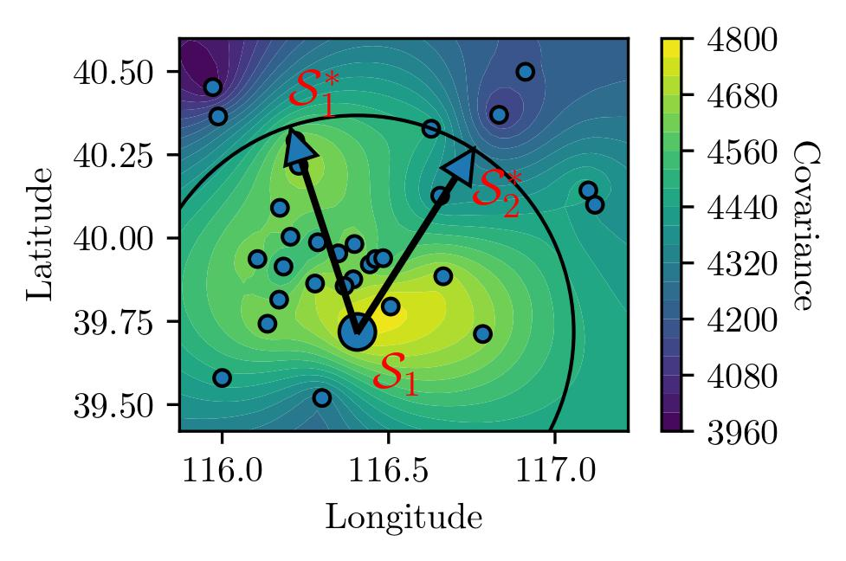
Checking Covariance Non-stationarity
Cov(𝑺₁, ᐧ)
Notes:
To investigate the non-stationarity, we use the spatio-temporal data from 36 stations in Beijing. We calculate the pairwise empirical covariance among these stations from multiple observations over time and plot the interpolated covariance between a station S1 and all other stations. From the definition of stationarity, locations S*_1 and S*_2 should have similar covariance with S1 because they are at the same distance from S1. However, the values of covariance at S*_1 and S*_2 are reasonably different. This motivates the need of a non-stationary kernel for our dataset.

Slide 22
Non-stationary GP
Plagemann et al.¹
Input depended length scales
1. Plagemann, Christian, Kristian Kersting, and Wolfram Burgard. "Nonstationary Gaussian process regression using point estimates of local smoothness." Joint European Conference on Machine Learning and Knowledge Discovery in Databases. Springer, Berlin, Heidelberg, 2008.
Notes:
To incorporate the non-stationarity we use a non-stationary GP approach proposed by Plagemann and others. As per this approach, we model the global behaviour of our data with a non-stationary kernel. The non-stationary kernel can have input dependent smoothness in resultant functions by having a separate lengthscale for each data-point. However, learning the individual lengthscales at all the datapoints can be computationally challenging and knowing the lengthscales at new datapoints is not possible.

Slide 23
Non-stationary GP
Notes:
To solve this problem, we can use a second level GP to model the lengthscales at a few locations and infer the lengthscales at all other locations with it. There could be multiple methods to fix the locations for the second level GP. In our work, we fit the KMeans clustering model to the dataset and take the cluster centers as the fixed locations.

Slide 24
Scalability
Cost of GP training: O(n^3), memory required: O(n^2)
Cost of Batch GP training: O(nm^2), memory required: O(m^2), m: batch size
Chen, Hao, et al. "Stochastic gradient descent in correlated settings: A study on gaussian processes." Advances in Neural Information Processing Systems 33 (2020).
Notes:
Now I will talk about scalability of our model.
Training cost of GPs is O(n^3) and it requires O(n^2) space to store the covariance matrix. If we could do batchwise training of GPs, it can reduce the training cost to O(nm^2) and memory requirement to O(m^2), where m is the batch size. However, the batch training was non-trivial in correlated settings till a recent work made it possible with several theoretical guarantees. We leverage the same algorithm to scale the training of our GP models.

Slide 25
Data & Experimental setup
Hourly granularity
Datasets
Beijing¹ : 36 stations : March 2015
London² (KDD Cup 18) : 24 stations : May 2017
Missing data is filled temporally
Data scaled to mean 0, std 1
K-Fold cross-validation
¹Cheng, W., Shen, Y., Zhu, Y., & Huang, L. (2018). A Neural Attention Model for Urban Air Quality Inference: Learning the Weights of Monitoring Stations. Proceedings of the AAAI Conference on Artificial Intelligence, 32(1).
²https://www.kdd.org/kdd2018/kdd-cup
Notes:
In our work, We have used hourly datasets from two cities (Beijing and London). Due to missing data constraints, we have used only one month of data from each of the cities which has the least amount of missing data. We fill in the missing data temporally for each station with linear interpolation. We scale our datasets to have mean 0 and standard deviation 1. We use K-Fold cross-validation for all the baselines as well as our approach.

Slide 26
Baselines
Random Forest Regressor
IDW (Inverse Distance Weighting)
XGBoost
K-Nearest Neighbors
ADAIN (Attentional Deep Air Quality Inference Network)¹ - AAAI ‘18
¹Cheng, W., Shen, Y., Zhu, Y., & Huang, L. (2018). A Neural Attention Model for Urban Air Quality Inference: Learning the Weights of Monitoring Stations. Proceedings of the AAAI Conference on Artificial Intelligence, 32(1)
Notes:
We have considered several widely applied baselines from the literature such as Random forest regressor, Inverse distance weighting, XGBoost and K-Nearest Neighbors. We have also implemented and used ADAIN, the state-of-the-art neural network model for air quality inference.

Slide 27
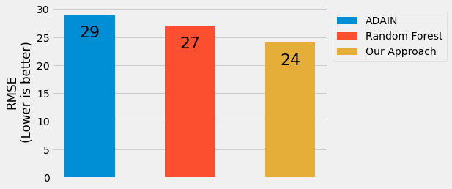
Results - Beijing dataset
Notes:
Here are the results over the top-3 models. Our results show that we are improving 17% over the state-of-the-art in terms of Root mean squared error.

Slide 28
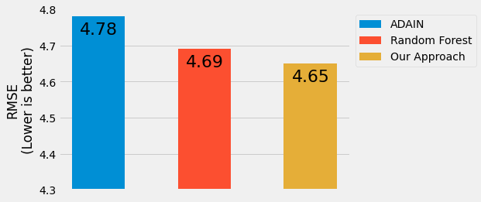
Results - London dataset
Notes:
We saw the similar results for the London dataset where our model outperforms all the other baselines.

Slide 29
Results - Predictions
Notes:
In this figure, we show the predictive performance of our model on a randomly selected test station. We can see that our model is capturing the trends in the data efficiently.

Slide 30
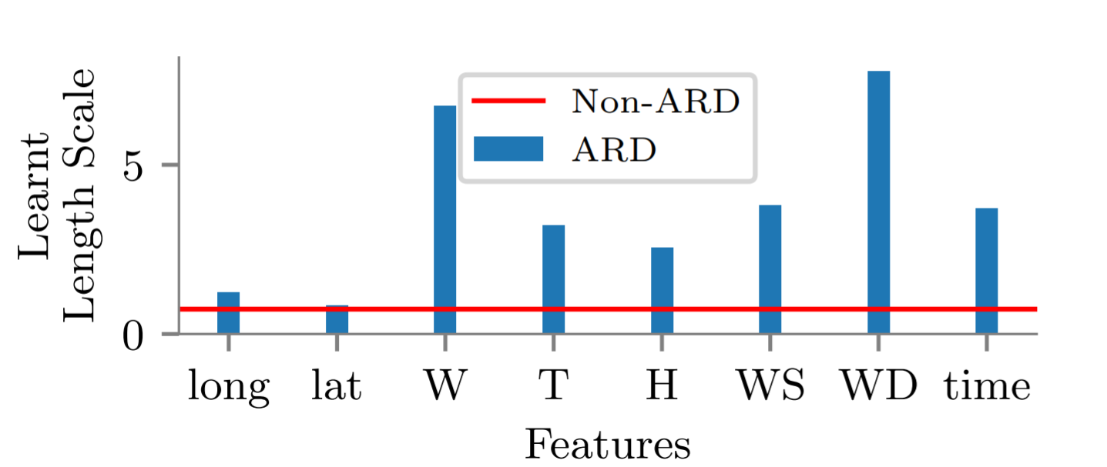
Results - Effect of Automatic Relevance Determination
Notes:
In this figure, we try to bring in the interpretability aspects of ARD lengthscales. Higher lengthscale implies that PM2.5 concentration varies slowly with the feature and vice versa. We can see that PM2.5 is smoothly varing with wind speed and it is varing rapidly with latitude and longitude.

Slide 31
Future work
src:https://ecolink.com/info/six-common-air-pollutants/
Notes:
In this work, we focused only on PM2.5, In future we will also work upon other pollutants such as PM10, Sulfure Dioxide and Nitrogen oxides.

Slide 32
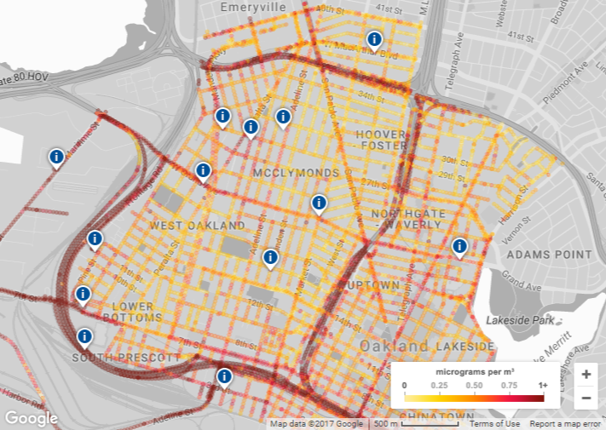
Future work
src:https://www.google.com/earth/outreach/special-projects/air-quality/
Notes:
To extend our work, we wish to get in touch with civic authorities to get fine-grained maps of air pollution. Our ideal goal would be that if we can get a Google maps layer for air pollution.

Slide 33
Summary
Domain inspired and uncertainty aware Gaussian process model for air quality inference.
Domain inspired kernels
Non-stationarity
Scalable training
17% improvement over state-of-the-art
Notes:
To summarize our work, we proposed a domain inspired and uncertainty aware Gaussian process model for air quality inference. We proposed domain inspired kernel combination based on characteristics of various features. We explore non-stationarity in data and employ a non-stationary kernel to model the same. We used batch training to scale our model to a large amount of data and finally, we improve the state-of-the-art by 17% percent.
We hope that our work will help provide measures to reduce the air pollution and save many lives.

Slide 34
Colab link
https://colab.research.google.com/drive/108DcwAxdW5QyRwkPHtpNLn3Ro5ANVSLi?usp=sharing

