Slide 1
Samachar: Print News Media on Air Pollution in India
Karm Patel^{1,} Rishiraj Adhikary^{2,} Zeel B Patel², Nipun Batra^{2,} Sarath Guttikunda³
¹ Upcoming M.Tech in
IISc Bangalore, India
² IIT Gandhinagar,
Gujarat, India
³ UrbanEmission.Info
New Delhi, India
Notes:
Btw English translation of Samachar is “News”

Slide 2
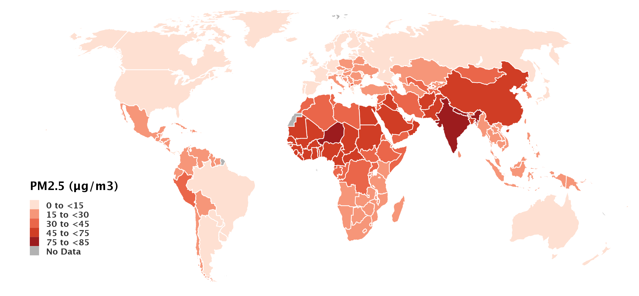
Air pollution in world
Average Annual Population-Weighted PM_{2.5} Concentrations in 2019
North Africa
South-East Asia
Source: Health Effects Institute. 2020. State of Global Air 2020. Data source: Global Burden of Disease Study 2019. IHME, 2020
Notes:
This map is showing annual average of PM2.5 level across all the countries in the world.
PM2.5 stands for particulate matter which is air pollutant having diameter less than 2.5 micron.
In most air pollution related studies, researcher uses PM2.5 as representative reading of air pollution .
Because among all the air pollutants PM2.5 poses greatest health risk.
if we look at this map then air pollution problem is prominent in South-east asia and North africa.

Slide 3
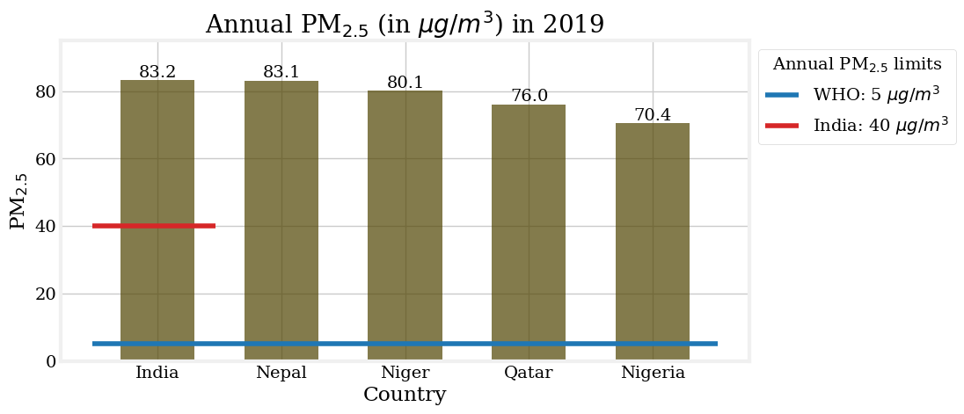
Most 5 polluted countries (Ambient PM_{2.5} pollution)
Source: Health Effects Institute. 2020. State of Global Air 2020. Data source: Global Burden of Disease Study 2019. IHME, 2020
Notes:
In particular if we see most 5 polluted countries in terms of ambient PM2.5 pollution, then India was on first position.
In our work, we particularly focus on India

Slide 4
Most 5 polluted countries (Ambient PM_{2.5} pollution)
Source: Health Effects Institute. 2020. State of Global Air 2020. Data source: Global Burden of Disease Study 2019. IHME, 2020
Notes:
Who has set annual PM2.5 limit by considering health effects of it, in that India was 16 times above than WHO limit and two times above India annual limit

Slide 5
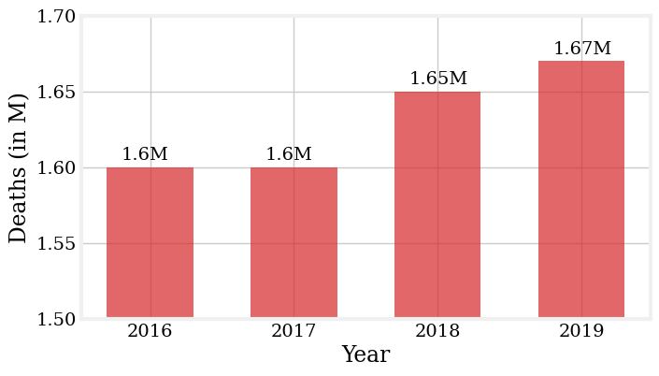
Air Pollution in India
Number of deaths due to air pollution
Source: Health Effects Institute. 2020. State of Global Air 2020. Data source: Global Burden of Disease Study 2019. IHME, 2020
Notes:
For year 2016-2019 air pollution contributes to more than 1.6M deaths in India.
Which states that air pollution is serious concern in India and there is strong need of awareness about air pollution in public
Here news media can play a important role in dissipating air pollution related information with people

Slide 6
News media impact
#1: Delhi’s Air Pollution (2015)
https://indianexpress.com/article/cities/delhi/death-by-breath-delhi-pollution/
Notes:
Let’s see two specific examples to illustrate this point
First examples is about ‘Death by Breath’ campaign started by one leading news paper - Indian express
Delhi is the capital of India and one of most polluted city in the world. Before 2015, there was hardly mention about air pollution in any media platform.
But in 2015 indian express started to publish bunch of articles talking about Delhi’s Air Pollution.
And This was one of the major event which played a big role in shaping public perception towards air pollution as well as motivated other news media to talk about on this topic.

Slide 7
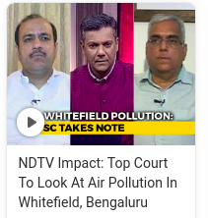
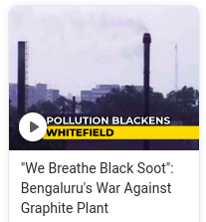
News media impact
#1: Delhi’s Air Pollution (2015)
#2:Polluting Industry in Bengaluru (2018)
https://indianexpress.com/article/cities/delhi/death-by-breath-delhi-pollution/
https://www.ndtv.com/topic/graphite-plant
Notes:
2nd examples is about big polluting industry in Bengaluru city.
Here people were facing air pollution issues due to this factory since 1980.
One Broadcast news media named NDTV did a special shows on these problems
In just next week this case was taken by SC
And after few months this industry has to shut up their company.
These examples shows that news media can play a pivotal role to influence public perception as well as they can help in taking actions to reduce air pollution.

Slide 8
Research Questions
Is the news media coverage around air pollution have a geographical and temporal bias?
Is the news media discussion is pertinent to scientific evidences?
Notes:
In our work, we have focused on two research questions.
<same>

Slide 9
News articles dataset
News media | Times of India | The Hindu
Total readers* | 17.3M | 8M
Time-period | Jan’10 to May’21 | Jan’10 to May’21
Total articles | 1.96M | 1.21M
Air quality articles | 11,746 | 5,628
Cities | 67 | 148
* Total readers till end of 2020
Notes:
- In our work, We particularly focus on two major English print news media: The times of India and The Hindu.
- We have chosen these media by considering their high readership, and well organized archives of news articles.
- We have extracted around 17.4K air pollution related articles from total pool of 3.17M articles spanning 11 years.

Slide 10
Snowball sampling
air pollution,
pm 2.5
Queries
Articles
Notes:
To decide whether given articles is air pollution related or not, we have used snowball sampling technique.
Here we have started with one query, we have collected articles mentioning this keyword - air pollution, after checking some of articles we found that there were other keywords like PM2.5 was frequently appearing, so we have included pm2.5 in our queries list

Slide 11
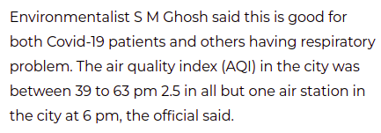
Snowball sampling
air pollution, pm 2.5,
AQI
Queries
Articles
Notes:
Similarly AQI was also appearing with these keywords so we have included it in queries list.

Slide 12
Snowball sampling
air pollution, pm 2.5, air quality, aqi, pm10, stubble burning, crop burning, ozone, air pollutants, sulphur dioxide, so2, carbon monoxide, smog, nitrogen dioxide, acid rain, odd even, car emissions
17.4 K News Articles
Queries
Articles
Notes:
After iterating this process multiple times, we collected full list of queries.
We have also manually checked 200 articles from 17.4K news articles to make sure if articles are related to air pollution only.

Slide 13
Air pollution (PM_{2.5}) Dataset
Number of cities | 87
Maximum time-span | 2010-2021*
Granularity level | 15 minutes
* Time-span of each cities is varying depending of installation of air quality monitors.
Source:
Central Pollution Control Board (CPCB)
OpenAQ
Notes:
We are using this PM2.5 dataset as a ground truth of air pollution for example we could compare air pollution level and number of news articles over time.
We have extracted PM2.5 for almost all cities from CPCB & OpenAQ

Slide 14
Research Questions
Is the news media coverage around air pollution have a geographical and temporal bias?
Is the news media discussion is pertinent to scientific evidences?
Notes:
Let’s see why we have framed our first RQ followed by its analysis.

Slide 15
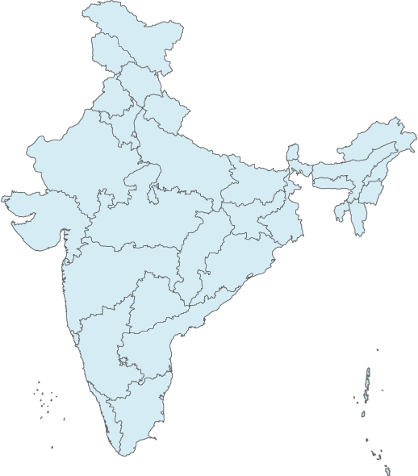
Why geographical bias matters?
City | PM_{2.5}(µg/m³)
Delhi | 142
Patna | 119
Delhi
India Annual PM_{2.5} limit: 40 µg/m³
Patna
Notes:
But why geographical bias even matters?
Consider two cities in India: Delhi & Patna,
If we see air pollution level of these cities then b oth are far from India annual PM2.5 limit

Slide 16
Why geographical bias matters?
City | PM_{2.5}(µg/m³) | Articles (2010-2021)
Delhi | 142 | 5300
Patna | 119 | 317
Delhi
India Annual PM_{2.5} limit: 40 µg/m³
Patna
Notes:
If we see number of news articles published in these cities, Delhi has 5300 articles Since it is capital of India while Patna has only 317 articles in 11 years.
And this is a problem, because if Delhi’s AP numbers coming more frequently in media, then people in Patna might feel safe by seeing less numbers than Delhi.
Is this happening for all polluted cities in India? If yes, then it’s a serious concern.

Slide 17
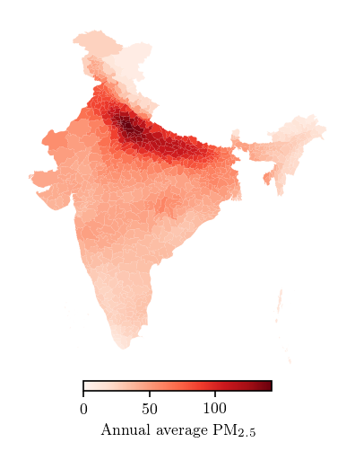
Air Pollution level in India
Indo-Gangetic
(IG) Plain
IG Plain is extremely polluted
Do news media focus on cities in IG plain?
Notes:
To find out polluted regions in India we have plotted annual average pm2.5 level across all the regions.
We can see that some regions in in North India is extremely polluted over others.
This region is Indo-Gengetic Plain in India, which is surrounded by rivers and mountains. <click>
Previous studies have shown that IG plain remains polluted due to emissions of primary sources of PM2.5 and unfavorable meteorology. <click>
So now question is do news media focus on cities in IG plain?

Slide 18
Cities in IG plain
India Limit
(40 µg/m³)
News media do not focus on most of the polluted cities in IG plain
Then, what are the cities get news media attention?
Notes:
For this question we have picked some major cities from IG plain.
And we compared air pollution level with number of news articles published in those cities.
Except Delhi. All other polluted cities hardly get news media attention, despite their worst air quality. <click>
Thus it’s clear that, <same1> <click>
But now question is <same2>

Slide 19
Metro cities
Metro cities (sorted by News Articles)
IG plain’s cities (sorted by Air Pollution)
India Limit
(40 µg/m³)
Notes:
- To answer this question, We have sorted cities based on the number of articles, we found that metropolitian cities in India are getting high news media attention,
- however their air pollution level is much less compared to cities in IG plain.

Slide 20
Metro cities
Metro cities (sorted by News Articles)
IG plain’s cities (sorted by Air Pollution)
India Limit
(40 µg/m³)
Notes:
- On the other side cities which are worst hit by air pollution do not getting news media coverage.
- Hence we conclude that there is strong geographical bias in news media reporting.

Slide 21
Temporal pattern: News media on Delhi
Periodic reporting after 2015
Notes:
- Let’s see one temporal pattern observed in time series Delhi’s news articles
- we have compared PM2.5 level and news media articles.
- As we can see here, when air pollution increases news media reporting also increases and so on.
- and this looks obvious, isn’t it?
- but Let me ask one question before commenting anything

Slide 22
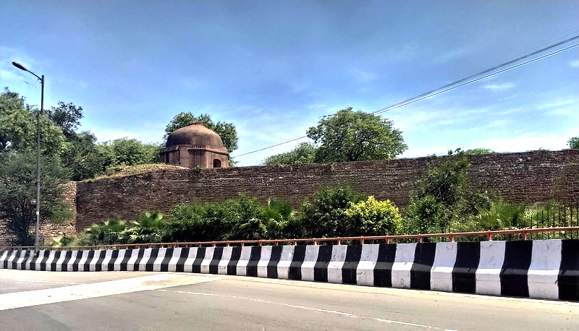
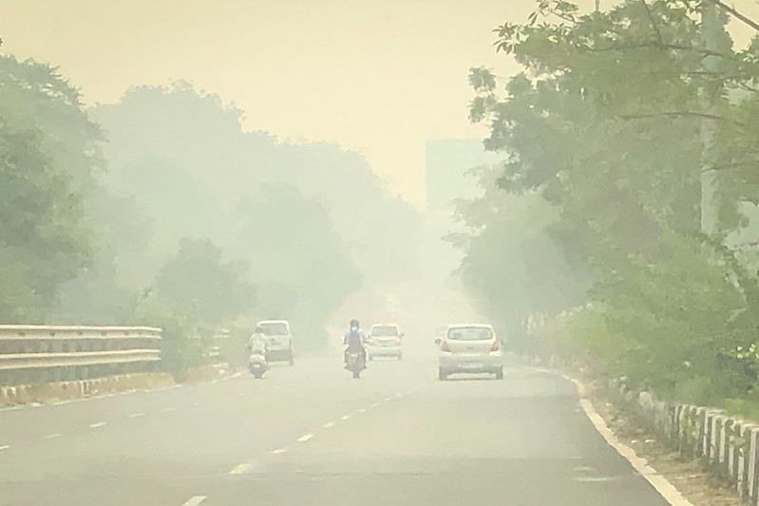
Which place is more polluted ?
A
B
Notes:
Yes <same>
Air pollution is not always visible, leading to incorrect perception. And that is what happening with news media reporting.
Let me explain this claim in brief,

Slide 23
Which place is more polluted ?
PM_{2.5}: 92 μg/m³
PM_{2.5}: 256 μg/m³
A
B
While B is more polluted. Pollution level in A is 6 times above the WHO limit!
Air pollution is not always visible, leading to incorrect perception.
Notes:
Yes B <click>
While B is more polluted. Pollution level in A is 6 times above the WHO limit! <click>
Air pollution is not always visible, leading to incorrect perception. And that is what happening with news media reporting.
Let me explain this claim in brief,

Slide 24
Temporal bias: News media on Delhi
82% of times above the India limit
Temporal bias!
Notes:
- After seeing this trend we found that Delhi is 82% of time above the India’s pm2.5 limit.
- but news media focuses on this issue when air pollution is high and visible as a smog in winter months and popularity of this topic is dies even though air pollution is year long problem in Delhi.
- & Again this is a concern because short lived discussion does not lead to any policy implications.

Slide 25
Research Questions
Is the news media coverage around air pollution have a geographical and temporal bias?
Is the news media discussion is pertinent to scientific evidences?
Notes:
In RQ2 we will dive deeper into news media discussions, in particular our RQ2 is, <same>

Slide 26
What are the topics discussed by news media?
Topic modeling
Unsupervised machine learning technique
‘latent Dirichlet allocation’ (LDA) algorithm.
Notes:
<click>
To get essence of news media discussion, Topic modeling would be ideal choice.
Topic modeling is an Unsupervised machine learning technique which returns some n topics and associated words.
In particular we apply latent dirichlet algorithm.

Slide 27
How LDA works?
Article #1
Article #2
Article #3
Article #4
Air pollution is a serious concern
Sport is good for health
Government should take action against air pollution
Football match canceled due to poor air quality
Air Pollution
Sports
Government
Notes:
Let’s take a look how LDA works in general.
Let’s assume we have 4 articles in our dataset and each articles has only one sentence for simplicity.
And we have three topics enlisted here. And we want to find out topics associated with given articles.

Slide 28
How LDA works?
Article #1
Article #2
Article #3
Article #4
Air pollution is a serious concern
Sport is good for health
Government should take action against air pollution
Football match canceled due to poor air quality
Air Pollution | 0.90 | 0.04 | 0.40 | 0.50
Sports | 0.01 | 0.95 | 0.05 | 0.45
Government | 0.09 | 0.01 | 0.55 | 0.05
Notes:
When we pass this articles to LDA model, then it will assign some probabilities to each topic.
For example in Article-1, model associate probability 0.9 to Air Pollution, 0.01 to Sports, and 0.09 to Government.
Hence by seeing max prob, article 1 is more likely to discuss about air pollution.

Slide 29
How LDA works?
Article #1
Article #2
Article #3
Article #4
Air pollution is a serious concern
Sport is good for health
Government should take action against air pollution
Football match canceled due to poor air quality
Air Pollution
Sports
Government
Air Pollution
Air Pollution | 0.9 | 0.04 | 0.40 | 0.50
Sports | 0.01 | 0.95 | 0.05 | 0.45
Government | 0.09 | 0.01 | 0.55 | 0.05
Notes:
Similarly we consider maximum probability for every articles and <click> Assign topic to that article accordingly.

Slide 30
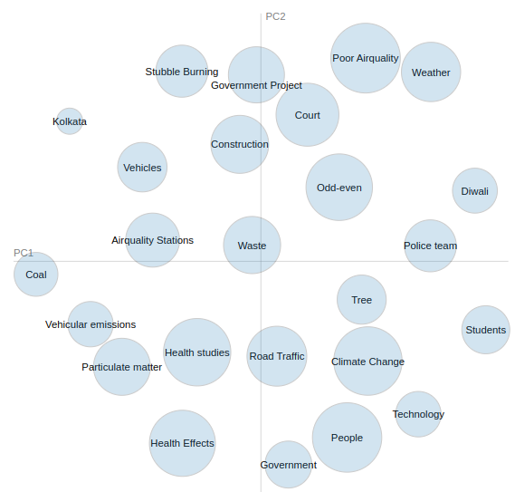
Topic modeling
Notes:
We can visualize output of topic modeling algorithm using this plot.
This plot is showing 25 topics discussed by news media. Radius of circle is showing number of articles related to that.

Slide 31
Topic modeling
Notes:
Distance between two circles denotes similarity between two topics. For example ‘court’ and ‘construction’ are close with each other which shows that generally court put ban on construction activities to reduce air pollution.

Slide 32
Odd-even vehicle rationing scheme in Delhi
Notes:
Let’s take a look at one specific topic: odd even and articles associated with it.
As given in first head-line odd even is vehicle rationing scheme implemented in Delhi to reduce air pollution by vehicles, where people having odd number-plates can use vehicles on odd days and vice-versa.
There has been lot of out-cry, support and sarcastic news about this scheme,
But do we know if this kind of reporting helps to reduce air pollution?

Slide 33
Topic modeling
3 Topics are related to vehicles
But, How much vehicles contribute to air pollution?
What are other Sources?
Are these sources discussed by news media?
Notes:
<n><n> In addition to that we can see 3 topics out of 25 are related to vehicles in air pollution related articles. <n>
But do we know how much vehicles are contributing to air pollution?<n>
And, what are major sources of air pollution? <n>
Do news media report about them proportion to their contribution?

Slide 34
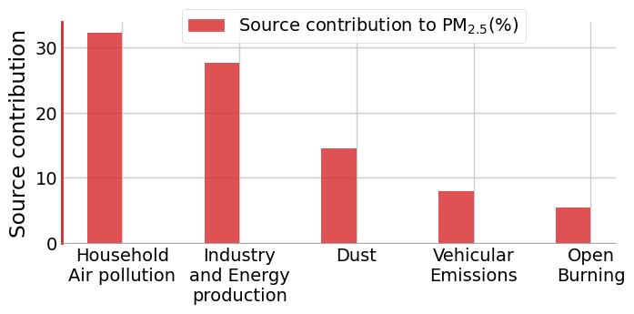
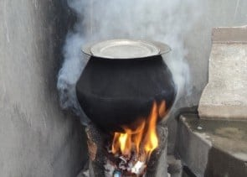
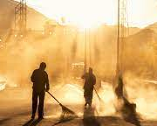
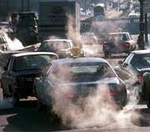
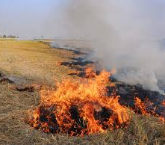
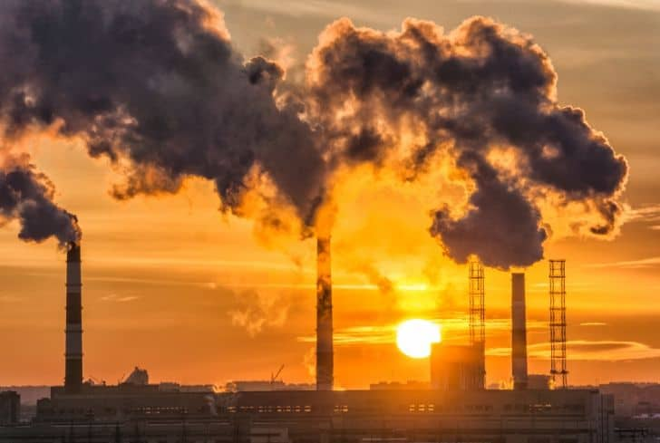
Source contribution in Delhi
https://doi.org/10.1038/s41467-021-23853-y
Notes:
- To answer these questions, we have identified major sources of air pollution from the previous study and plotted their contribution to pm2.5.
- We focused only on Delhi to avoid diverse distribution of sources across various regions.<click>
- We can see house-hold air pollution contribute highest in air pollution in Delhi.

Slide 35
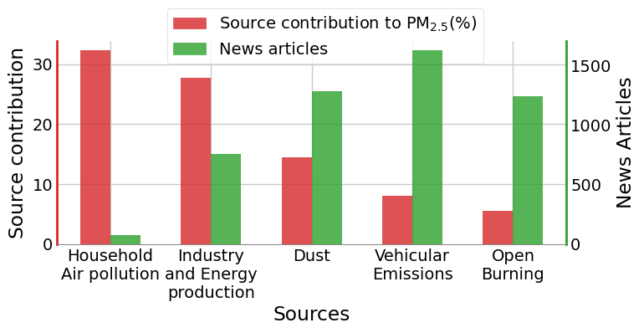
Source contribution in Delhi
Notes:
Here we compared source contribution and number of articles in which this source is mentioned.

Slide 36
Source contribution in Delhi
Notes:
We have observed that `house hold air polluion` has highest contribution towards PM2.5 but only few articles mentioned about it.

Slide 37
Source contribution in Delhi
Notes:
On the other side vehicular emissions related articles are highest but it’s contribution to PM2.5 is only 8%.
We conclude that news media focus on quickly visible sources such as vehicular emissions and open burning, but they missed to report about house hold sources despite its significant contribution in air pollution.

Slide 38
Source contribution in Delhi
https://www.pnas.org/doi/full/10.1073/pnas.1900888116
Notes:
In fact there has been studies which is saying that if all people in India started to use cleaner fuels then India can meet their PM2.5 standards.
News media can cite this kind of studies to motivate people to use cleaner fuels such as LPG or electric stove

Slide 39
Summary
Geographical bias
No coverage in Polluted cities (IG plain)
More attention on metro cities (which are not polluted)
Temporal bias
Air pollution is year long problem in India.
Periodic news media reporting.
Reporting on source contributions deviate from the scientific studies.
Notes:
Here I summarize our work in 3 main findings,
<n>*3: News media focus on the air pollution issue of metropolitan cities rather than the cities which are worst hit by air pollution
<n>*3: Although air pollution is a year-long problem in India, the news media limelight on the issue is periodic (temporal bias)
<n>: the air pollution source contributions discussed in news articles significantly deviate from the scientific studies.
Thank you, I’m open for questions now.

