Slide 1
SpiroMask: Measuring Lung Function Using Consumer Grade Masks
Rishiraj Adhikary
Research Scholar, Computer Science and Engineering
Indian Institute of Technology (IIT) Gandhinagar
Date: 28 April 2022
https://rishi-a.github.io/

Slide 2
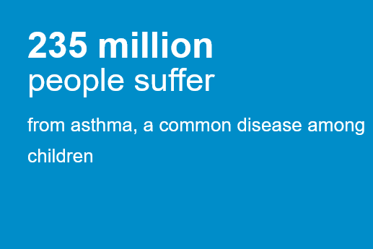
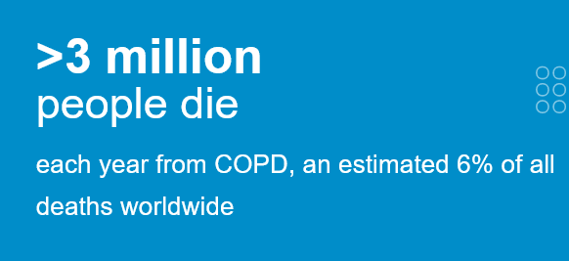
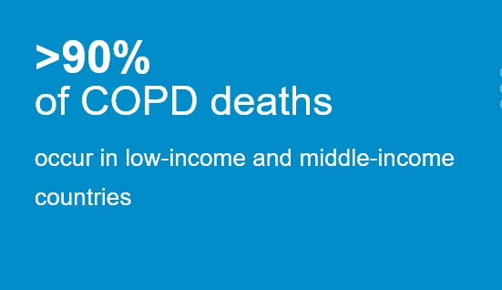
Motivation
Source: WHO

Slide 3
Motivation
According to LANCET global health studies, the number of cases of COPD in India increased from 28·1 million in 1990 to 55·3 million in 2016, an increase in prevalence from 3·3% to 4·2%.
53·7% of DALY due to COPD were attributable to air pollution, 25·4% to tobacco use, and 16·5% to occupational risks.

Slide 4
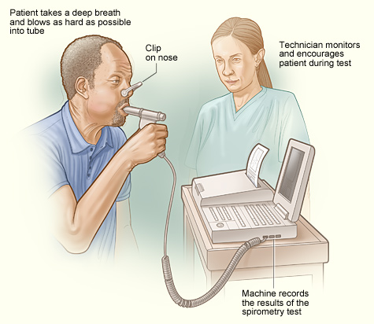
Diagnosis of Respiratory Diseases
Pulmonary Function Test: a test designed to measure the working of the lungs.
physio-pedia.com
DEMO

Slide 5
Diagnosis of Respiratory Diseases
Forced Breathing:
Normal Breathing:

Slide 6
Diagnosis of Respiratory Diseases
Forced Breathing:
Forced vital capacity (FVC). This is the amount of air exhaled forcefully and quickly after inhaling as much as you can.
Forced expiratory volume (FEV). This is the amount of air expired during the first, second, and third seconds of the FVC test.
Peak expiratory flow rate (PEF). This is the fastest rate that you can force air out of your lungs.
Normal Breathing:
Respiratory Rate (RR). This is the amount of air exhaled forcefully and quickly after inhaling as much as you can.

Slide 7
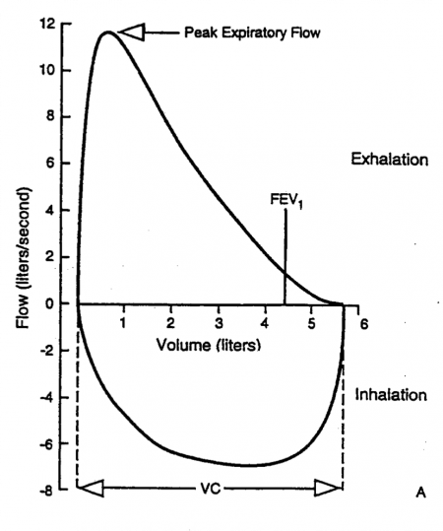
Diagnosis of Respiratory Diseases
Forced Breathing:

Slide 8
Objective
Measure Forced Breathing and Continuous Normal Breathing Parameters Using Commodity-Grade Mask

Slide 9
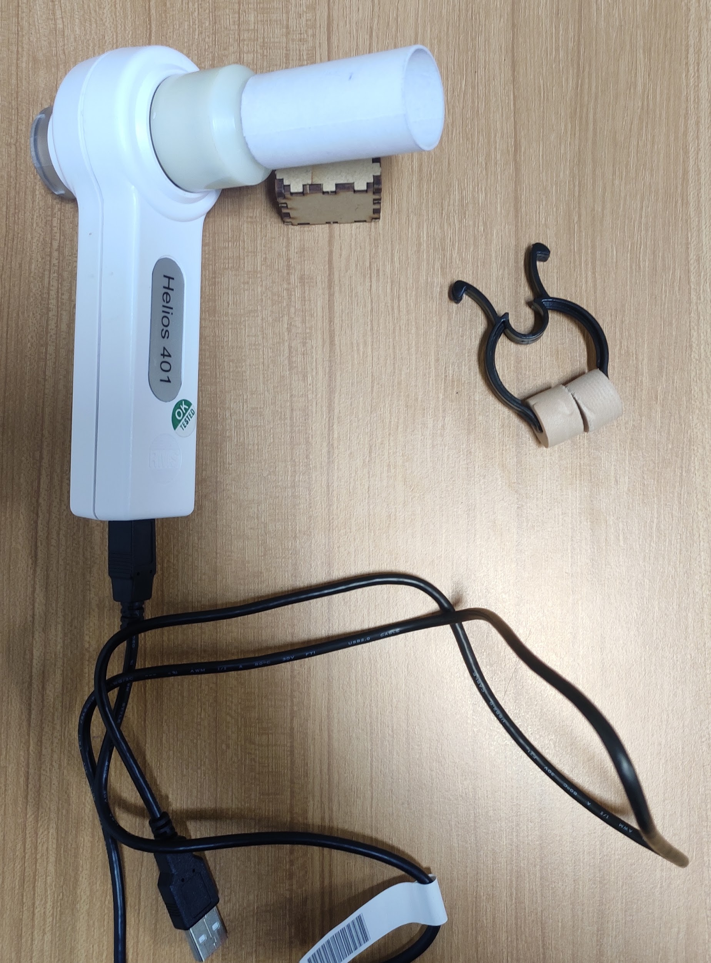
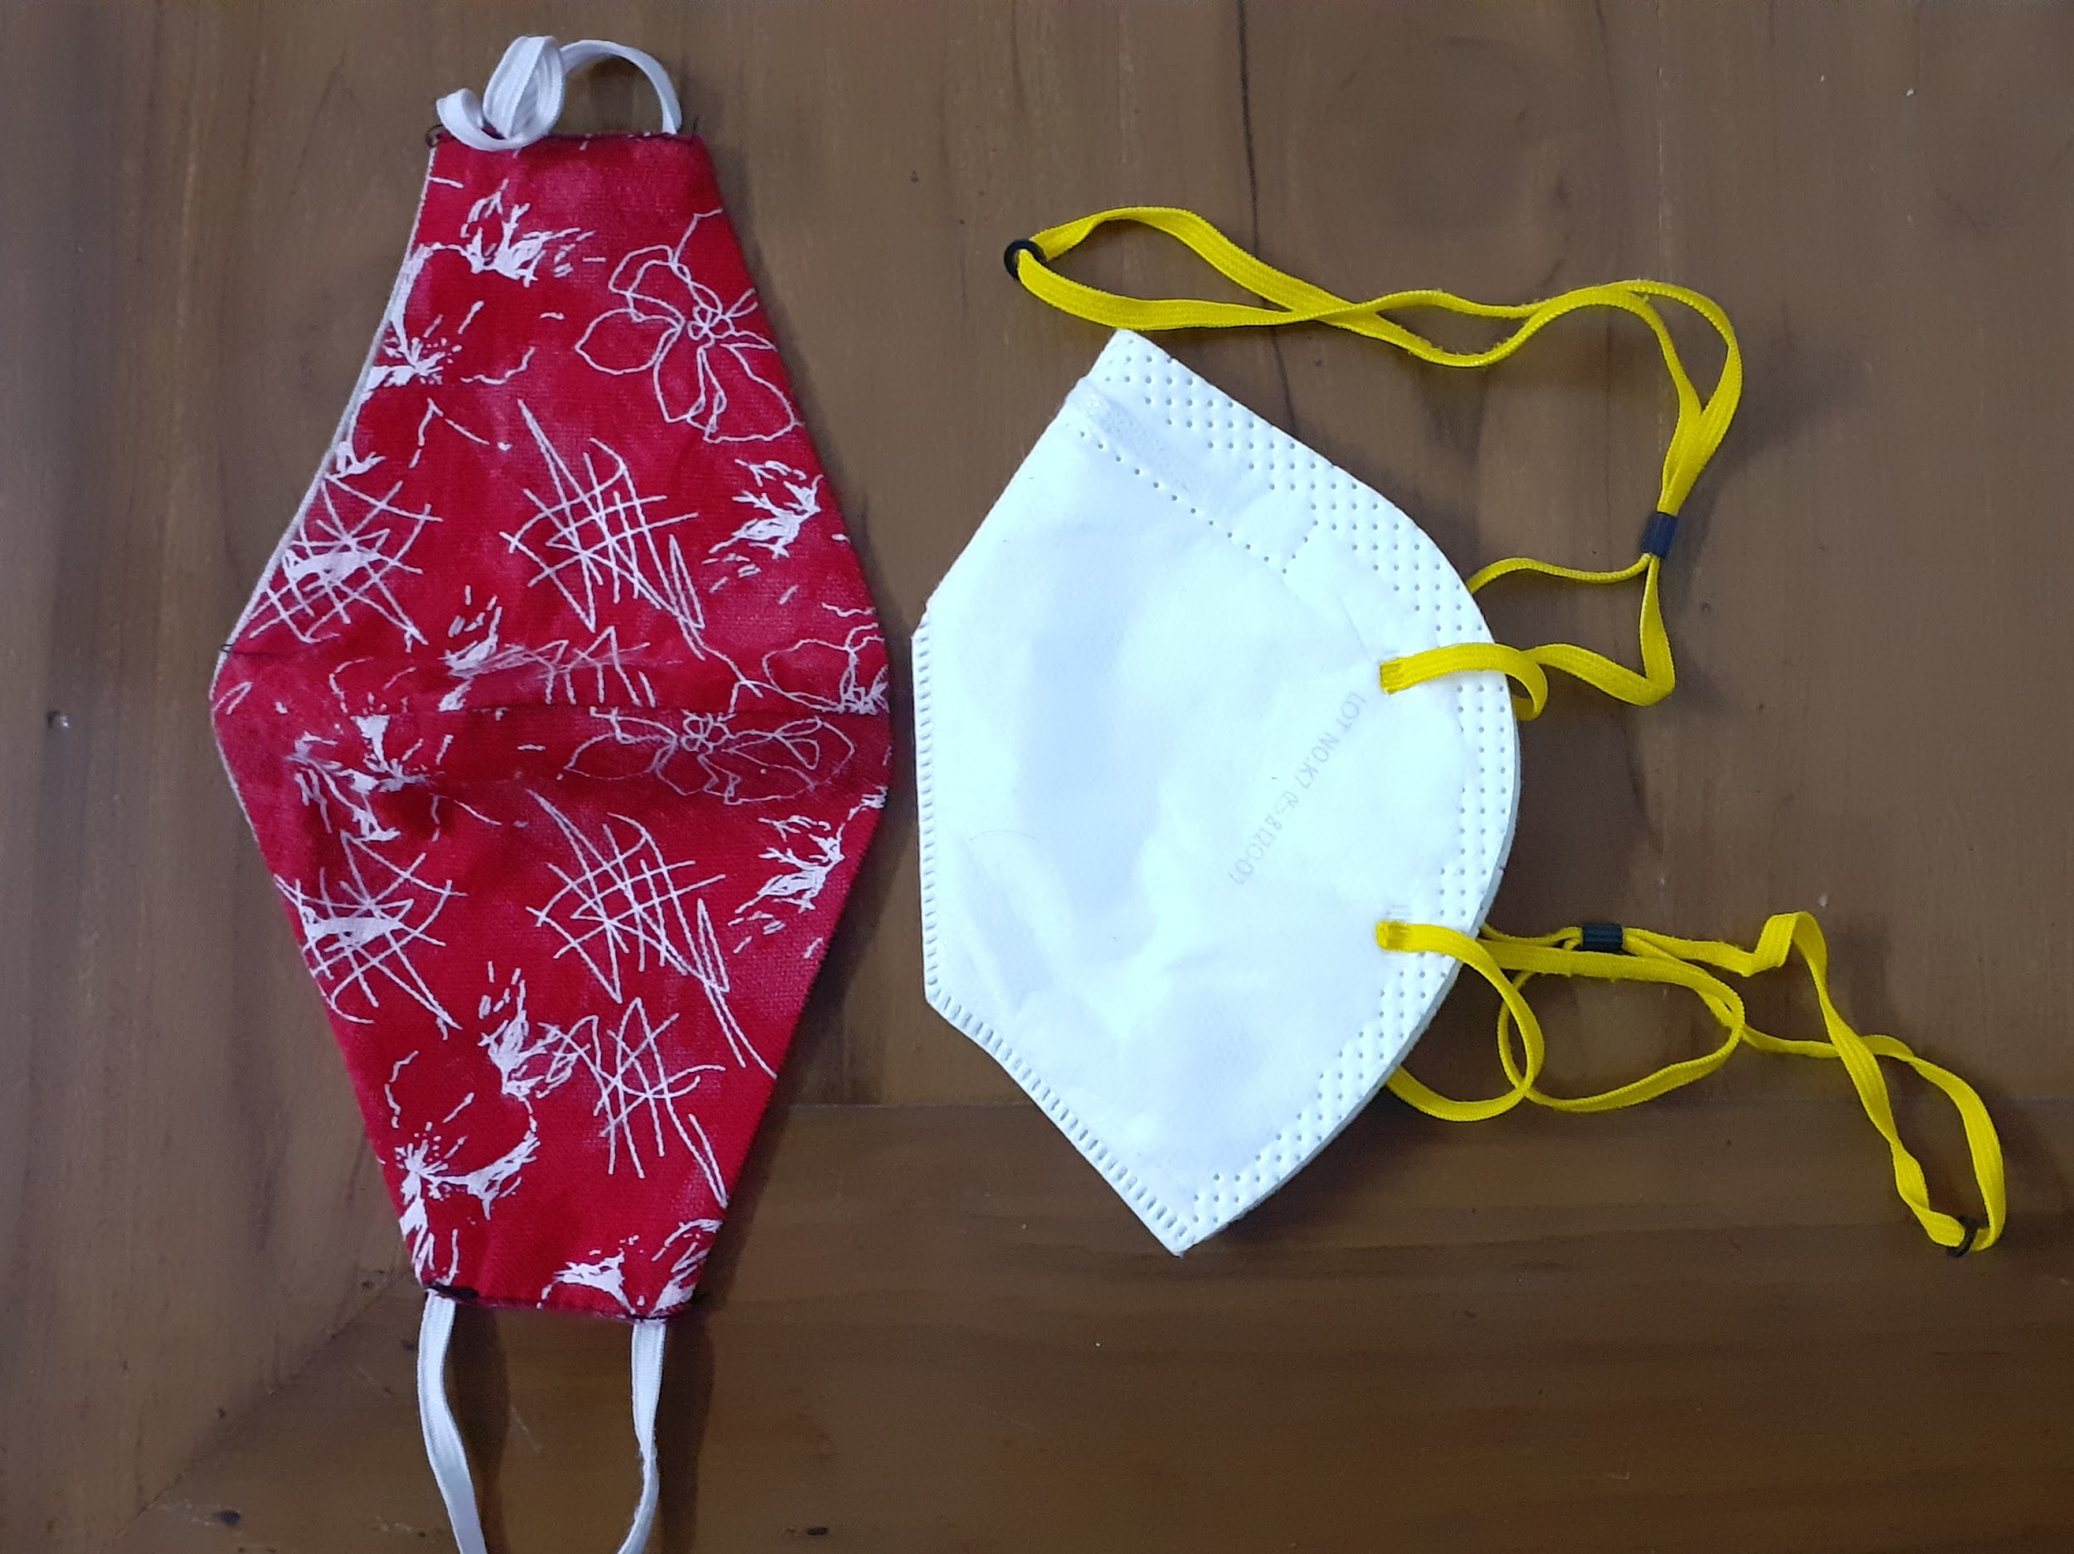
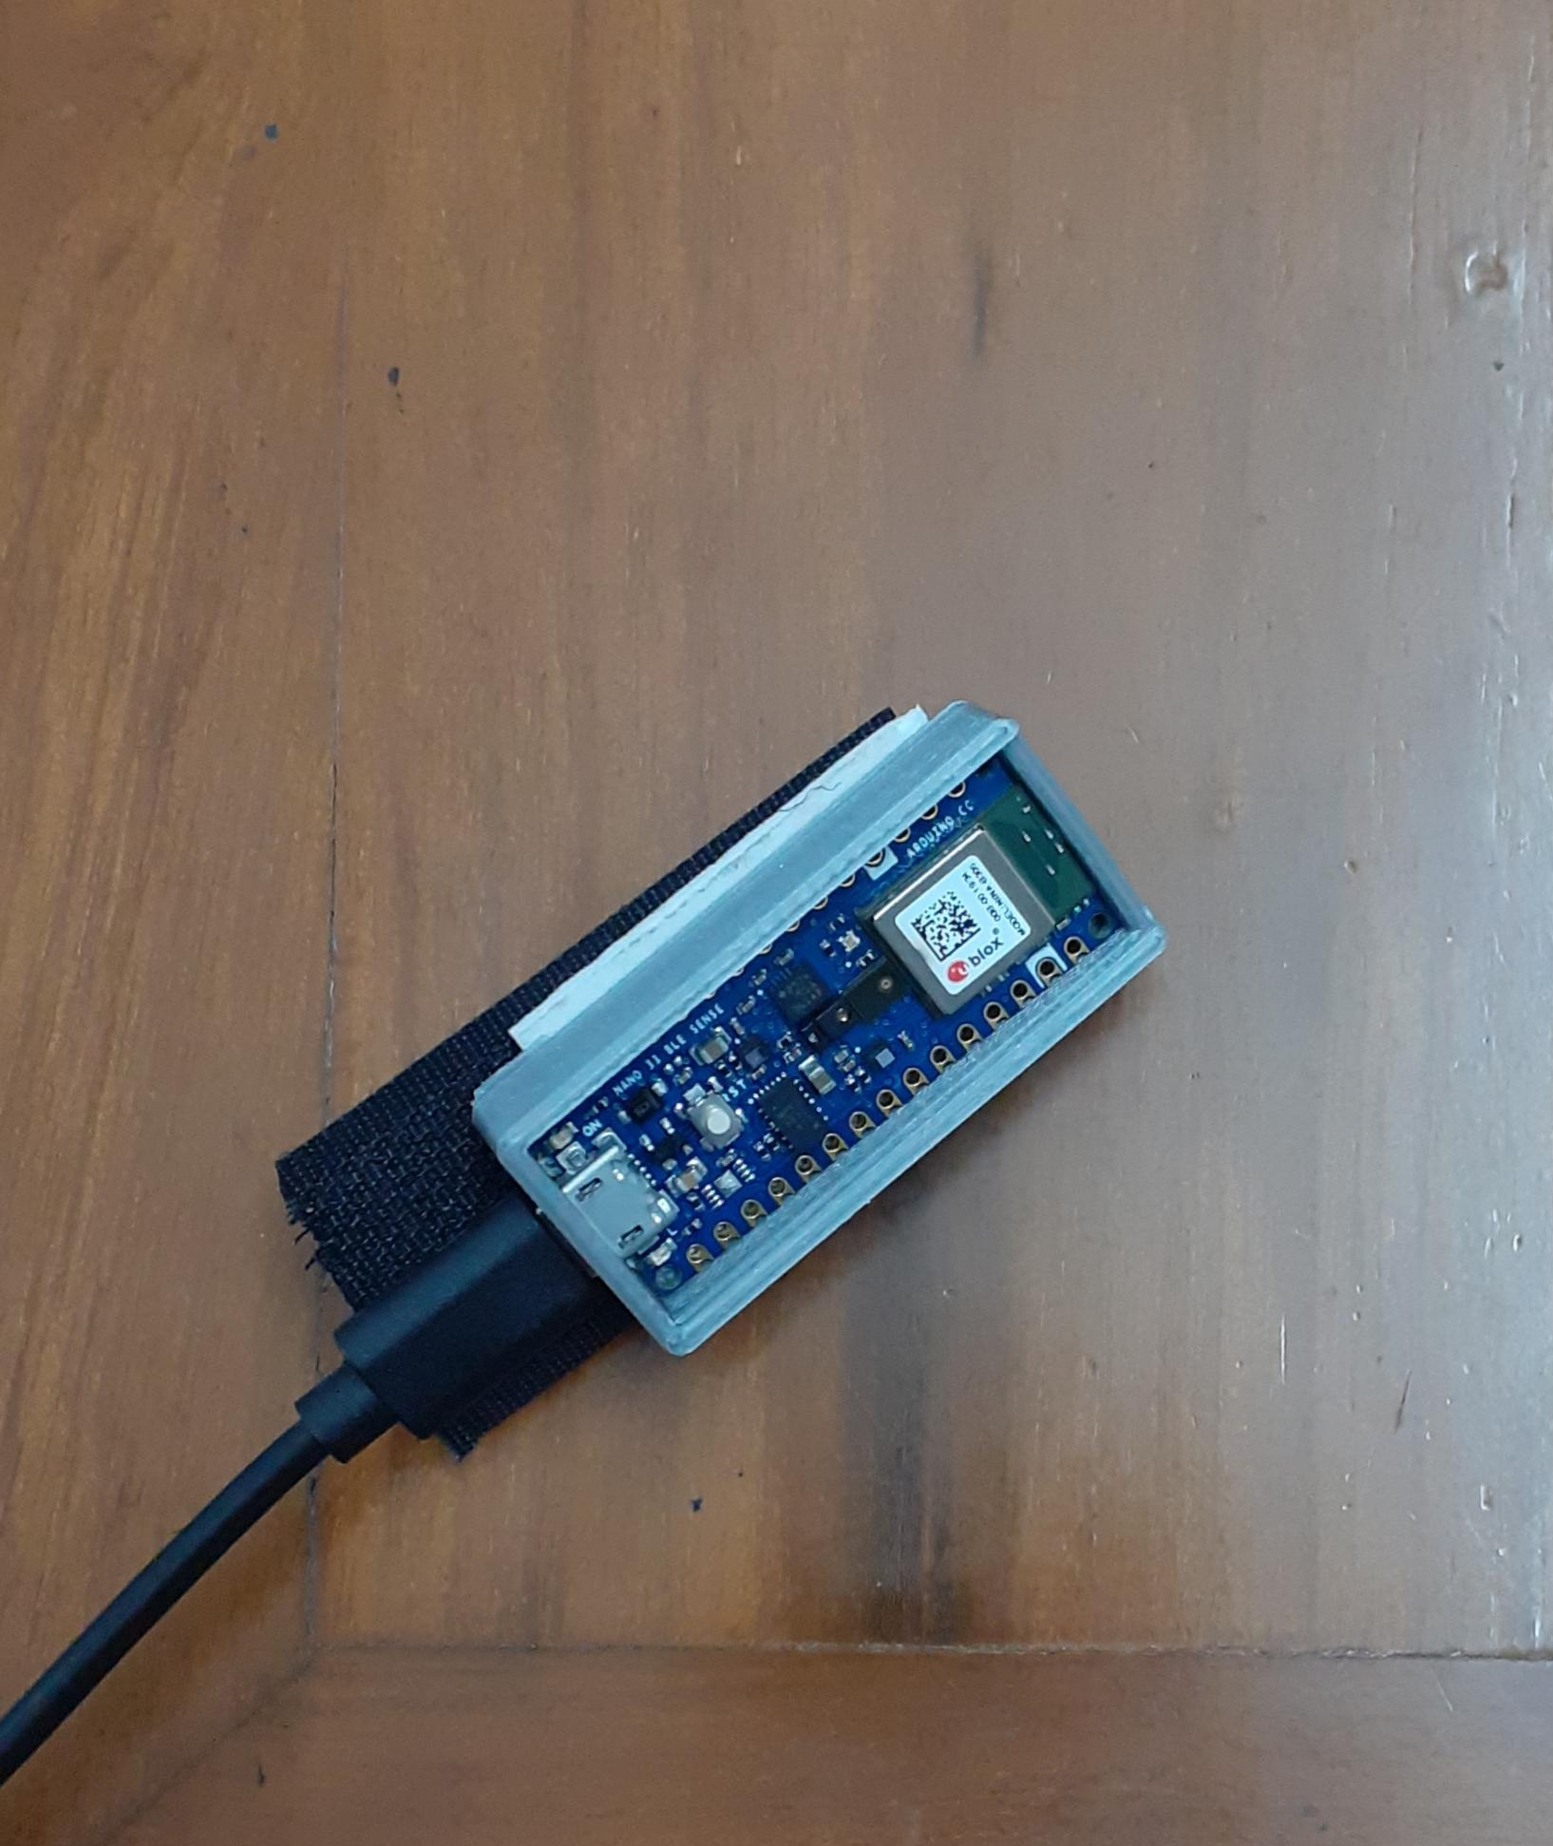
Approach
Data Collection: Peripherals
Spirometer Mouthpiece
Nose Bracket
Velcro
Nose Clip
Ear Lobes
Microcontroller
N95 Mask
ii)
iii)
i)
Cloth Mask

Slide 10
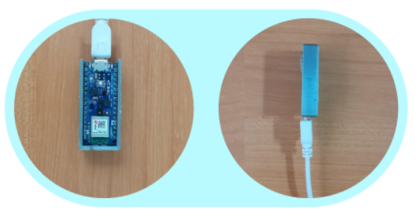
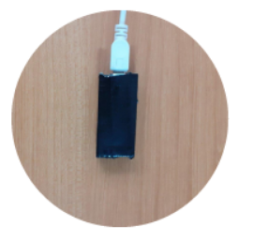
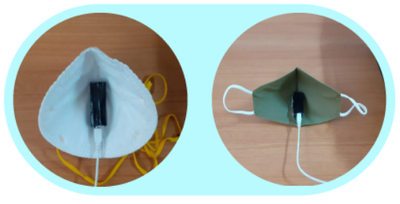
Approach
Data Collection: Prototype
i)
ii)
iii)

Slide 11
Approach
Data Collection: IEC/IRB Approval
Research involving human subjects must receive IEC approval in accordance with ICMR regulations. It took us 2 Months to get IEC approval!

Slide 12
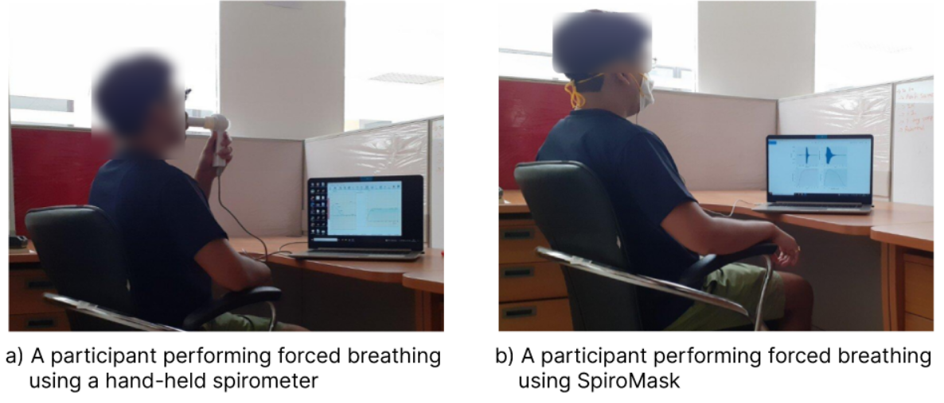
Approach
Data Collection:

Slide 13
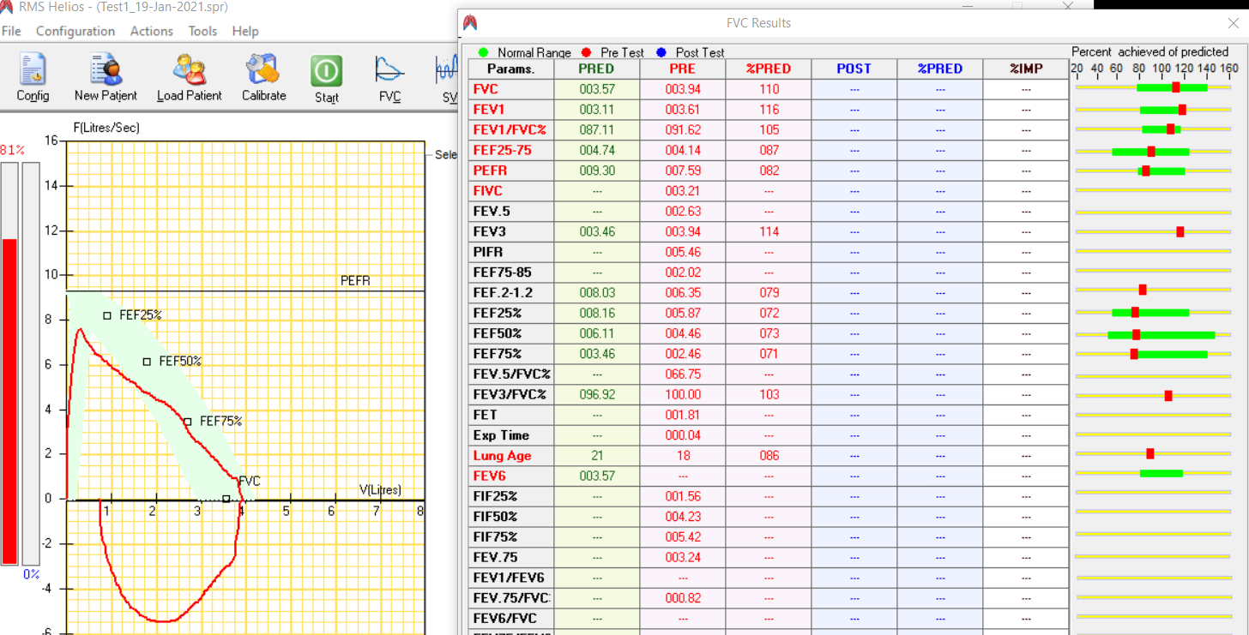
Approach
Data Collection: Ground Truth For Forced Breathing

Slide 14
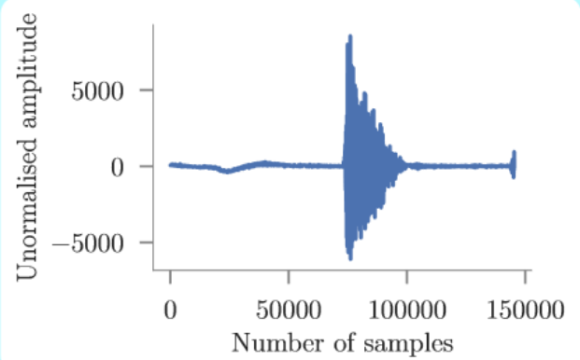
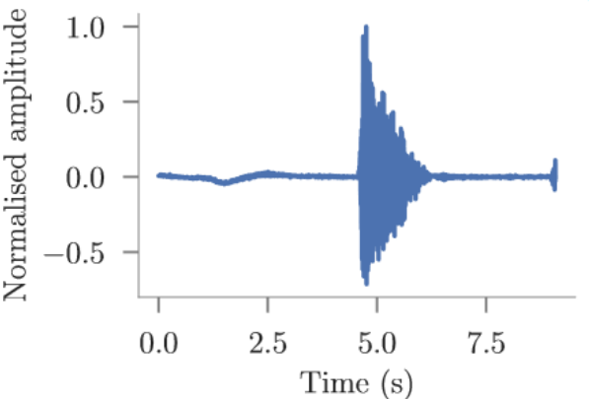
Approach (Forced Breathing)
Deriving the Flow-Volume Curve From Audio Signal:

Slide 15
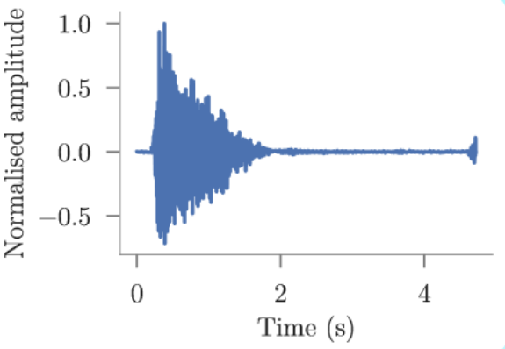
Approach (Forced Breathing)
Deriving the Flow-Volume Curve From Audio Signal:
Clip In Time

Slide 16
Approach (Forced Breathing)
Deriving the Flow-Volume Curve From Audio Signal:
Clip In Time
Generate Acoustic Features

Slide 17
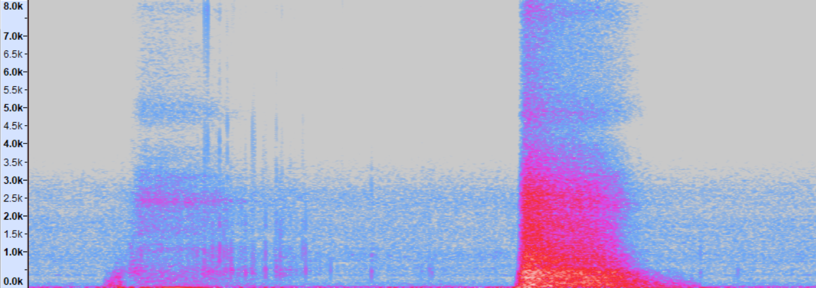
Approach (Forced Breathing)
Deriving the Flow-Volume Curve From Audio Signal:
Most of the information is below 3500 Hz. We use a Low Pass Filter

Slide 18
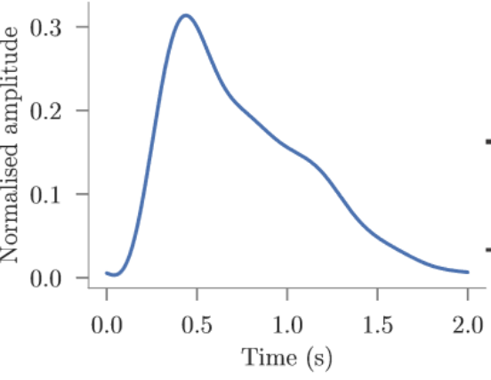
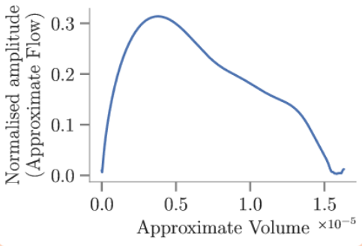
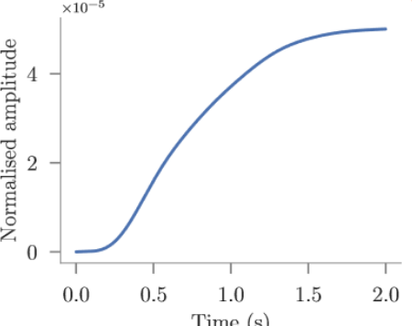
Approach (Forced Breathing)
Acoustic Features and Envelope
Mel Frequency Cepstral Coefficient
Mel Frequency Energy
Chroma Vector
Temporal Features
Hilbert Envelope

Slide 19
MFCC
Mel Frequency Cepstral Coefficient

Slide 20
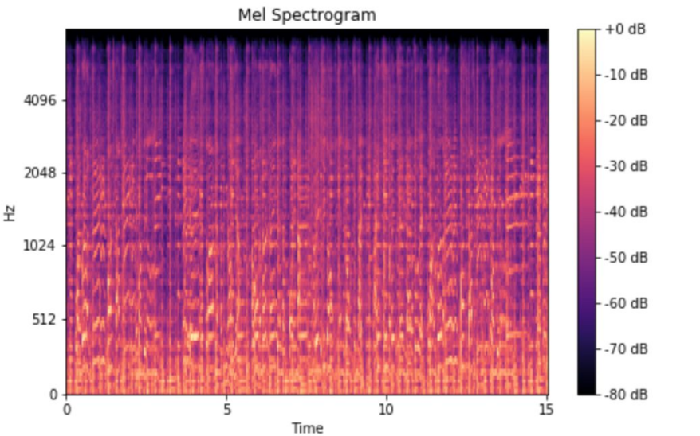
MFCC
Mel Frequency Cepstral Coefficient

Slide 21
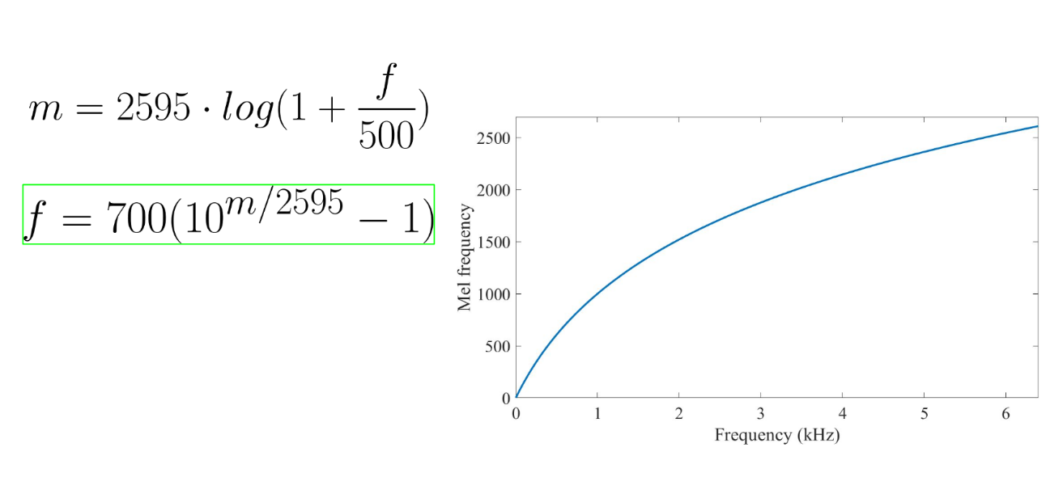
MFCC
Mel Frequency Cepstral Coefficient

Slide 22
MFCC
Mel Frequency Cepstral Coefficient
Humans perceive frequencies logarithmically!

Slide 23
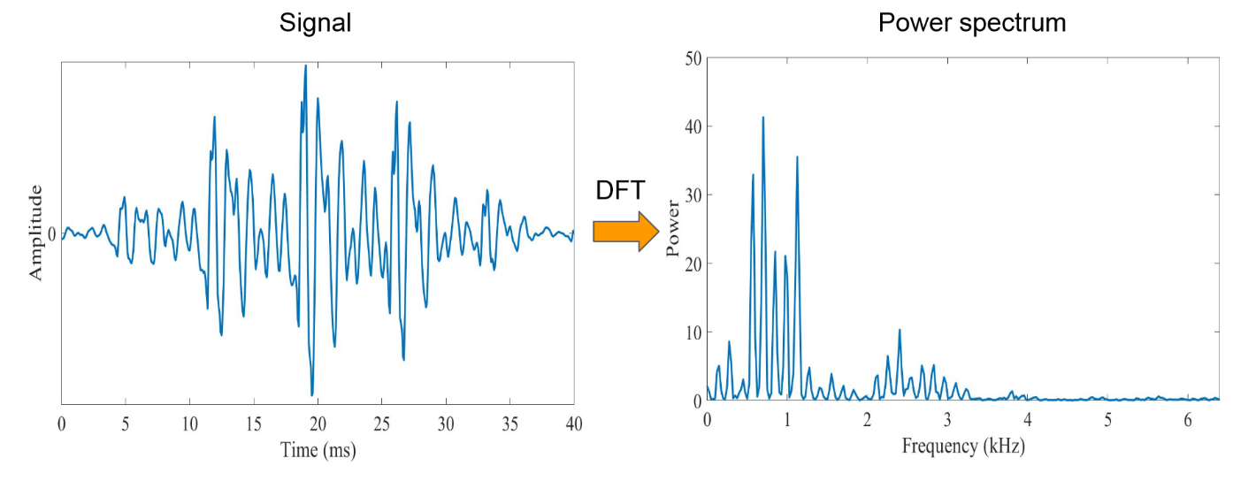
MFCC
Mel Frequency Cepstral Coefficient

Slide 24
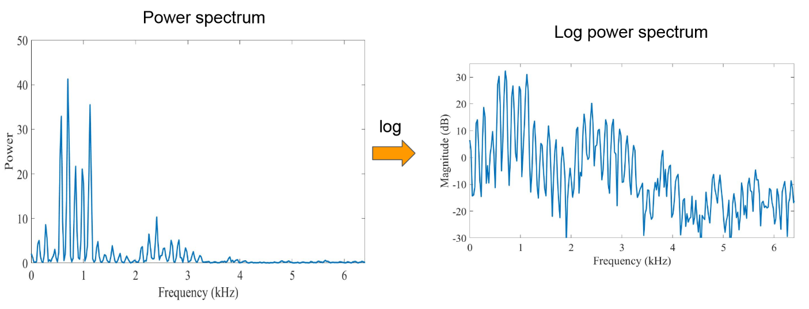
MFCC
Mel Frequency Cepstral Coefficient

Slide 25
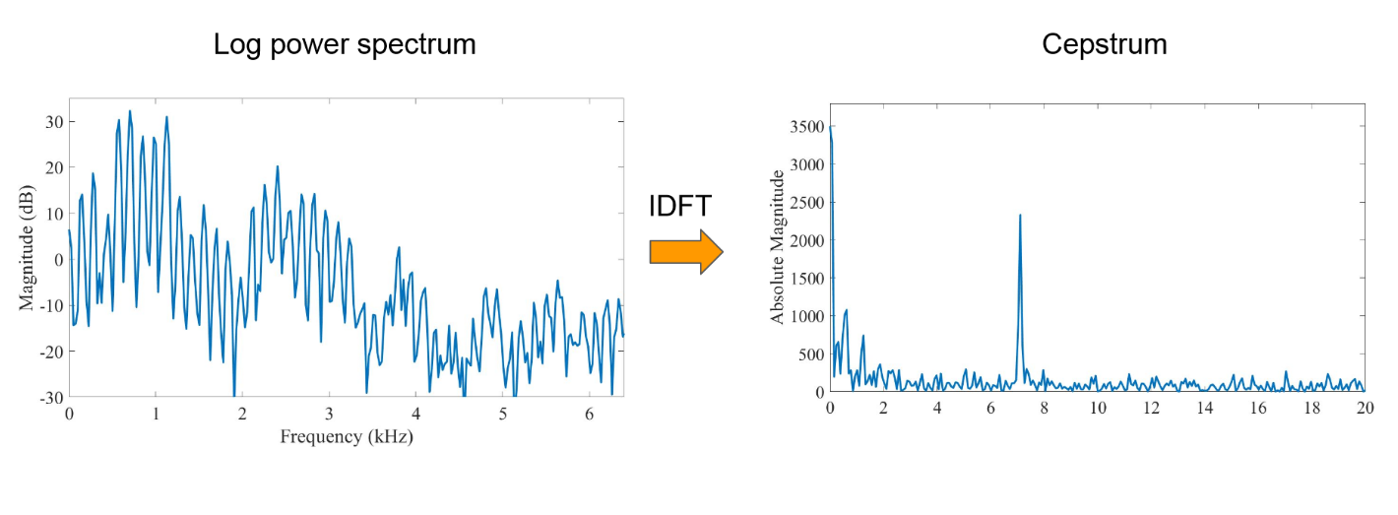
MFCC
Mel Frequency Cepstral Coefficient

Slide 26
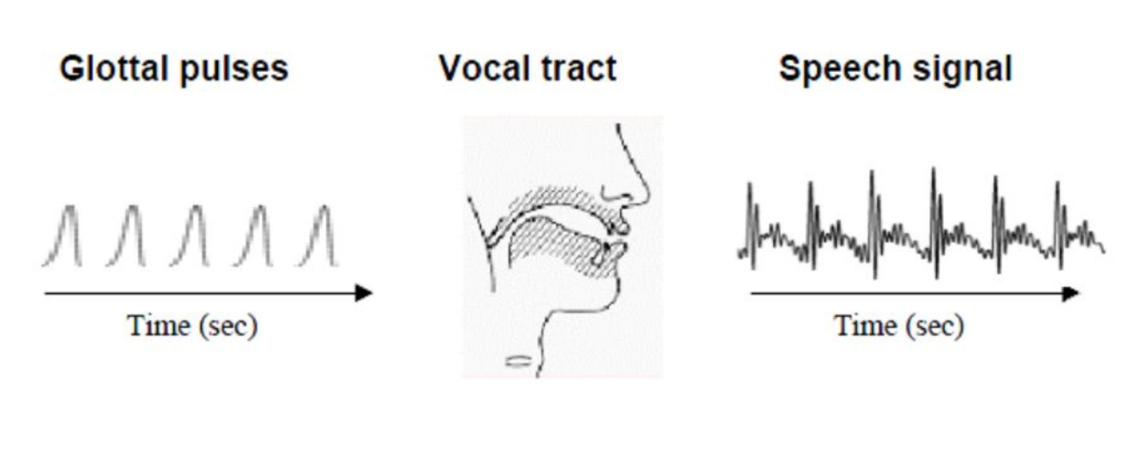
MFCC
Mel Frequency Cepstral Coefficient

Slide 27
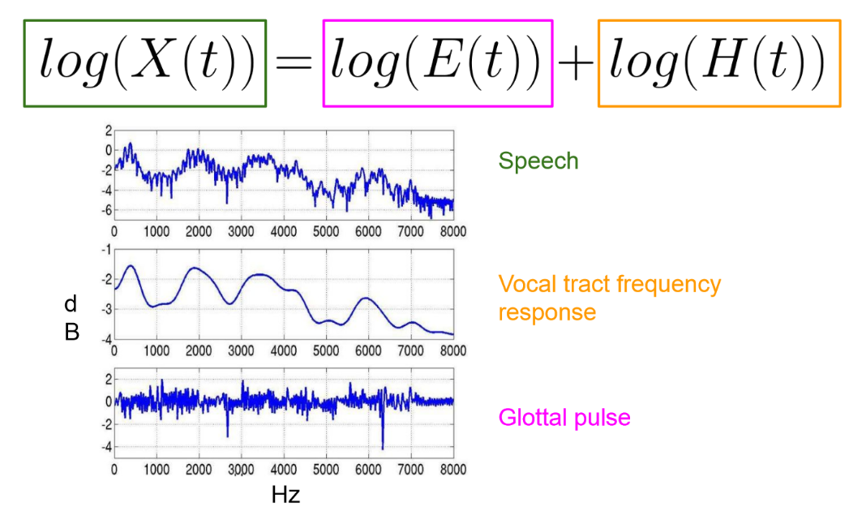
MFCC
Mel Frequency Cepstral Coefficient

Slide 28
Approach (Forced Breathing)
Acoustic Features and Envelope
Question: How do we use these features to predict three parameters? (FVC, FEV1 and PEF)?

Slide 29
Approach (Forced Breathing)
Acoustic Features and Envelope
Question: How do we use these features to predict three parameters? (FVC, FEV1 and PEF)?

Slide 30
Approach (Forced Breathing)
Acoustic Features and Envelope
Question: How do we use these features to predict three parameters? (FVC, FEV1 and PEF)?
Question: Why are we using MFCC, MFE and Chroma Vector?

Slide 31
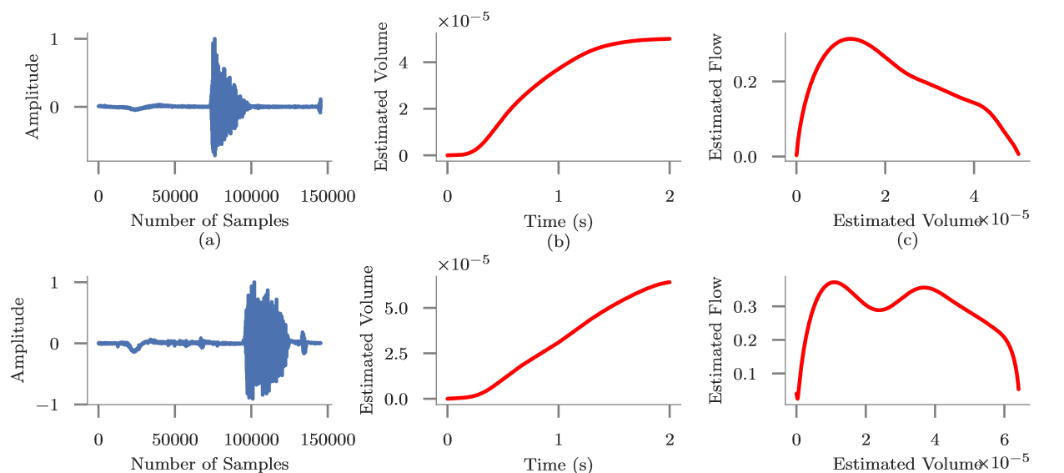
Evaluation (Forced Breathing)
Not all Forced Breathing Samples Are Correct

Slide 32
Evaluation (Forced Breathing)
We used Random Forest Regression using LOOCV to predict FEV1, PEF and FVC.

Slide 33
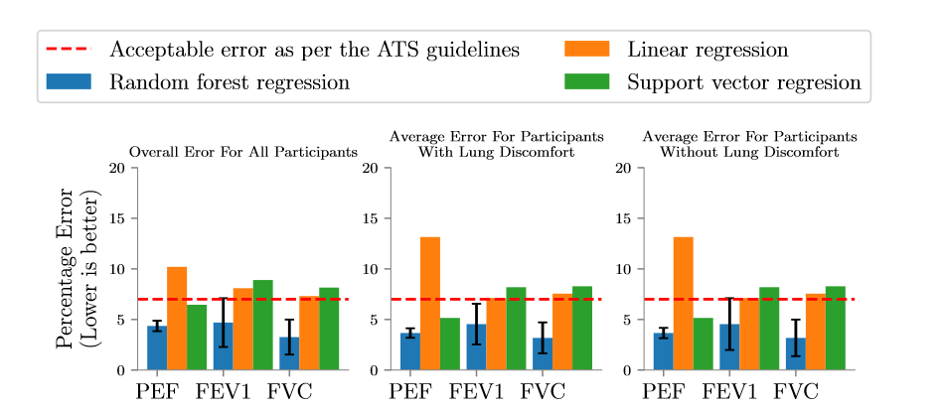
Result (Forced Breathing)

Slide 34
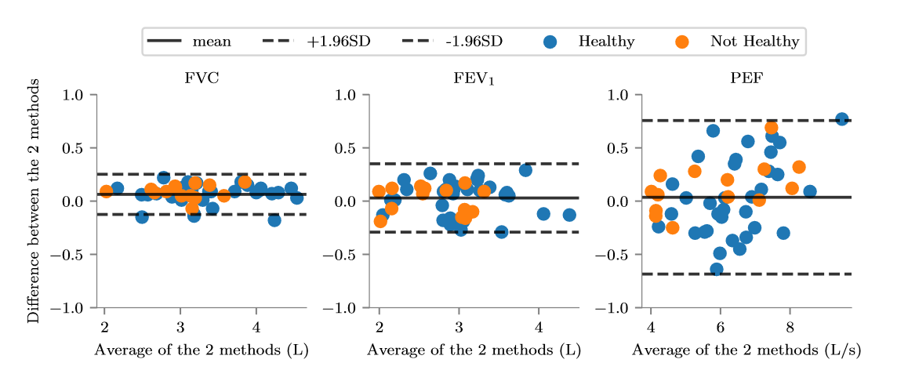
Result (Forced Breathing)

Slide 35
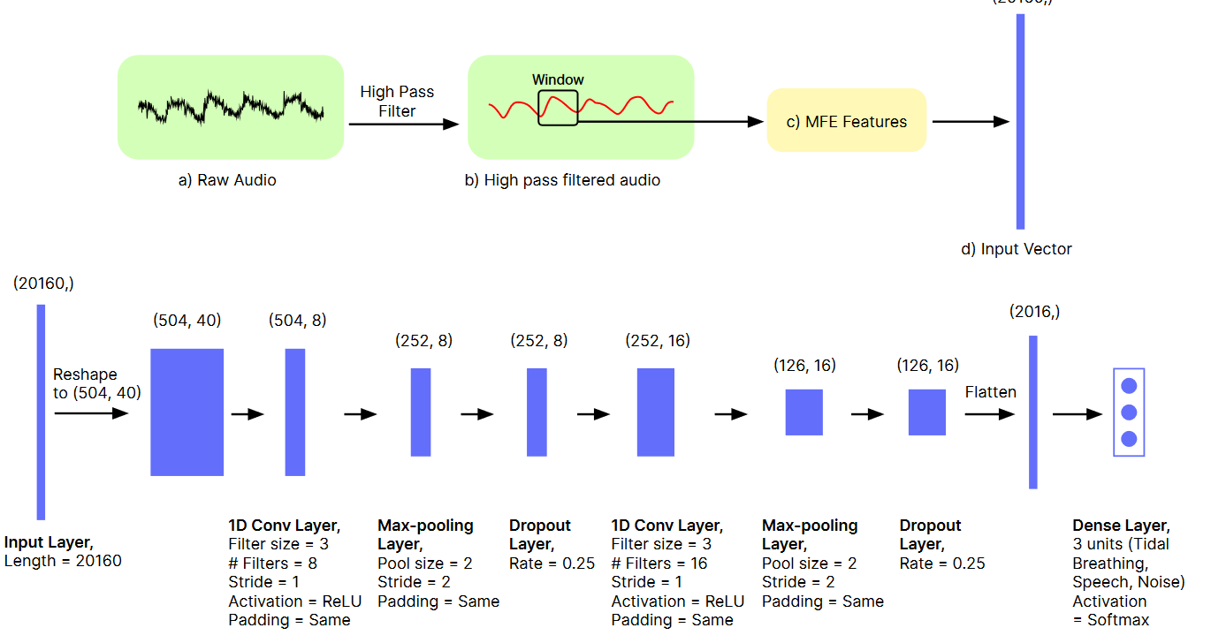
Approach (Normal Breathing)
Data Collection: Classification

Slide 36
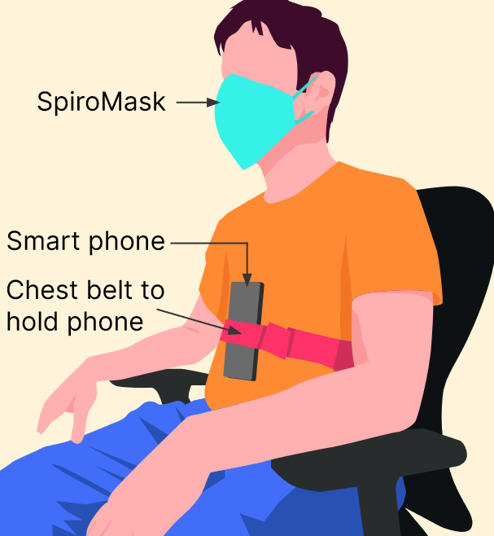
Approach
Data Collection: Ground Truth For Normal Breathing
1.
2.
Metronome

Slide 37
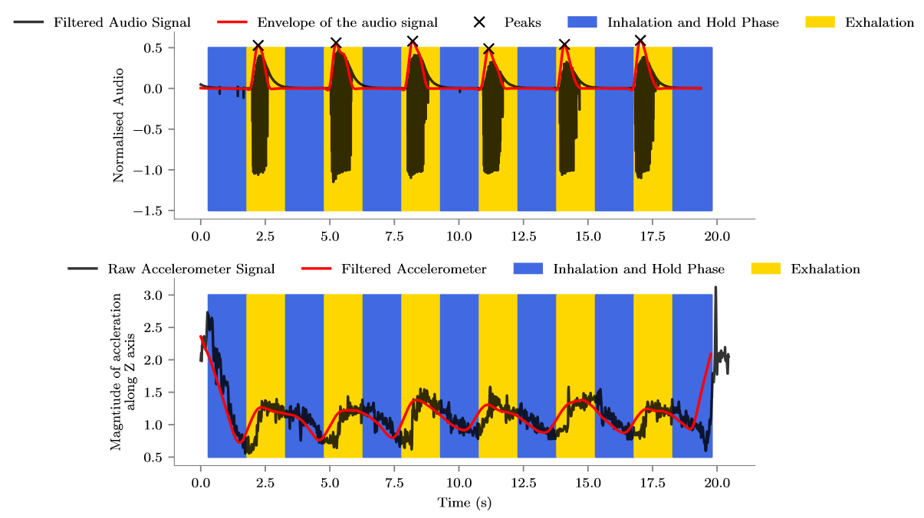
Approach
Data Collection: Ground Truth For Normal Breathing

Slide 38
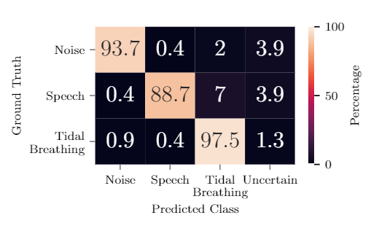
Evaluation and Result (Normal Breathing)

Slide 39
Evaluation and Result (Normal Breathing)
For respiration rate monitoring, we achieved a Mean Absolute Error (MAE) of 0.47 on the N95 mask. The MAE on the cloth mask was 0.36

Slide 40
Thank you.
I skipped some details, like:
Sensitivity Analysis on position of the sensor inside the mask.
Analysis of variance test to find confounding factors.
Participant’s feedback.

Slide 41
Thank you.
SpiroMask Team:
Prof. Nipun Batra.
Chris and Dhruvi (BTech Students @ IIT Gandhinagar).
Members of Ubicomp Lab at UW including Prof. Shwetak Patel.

